Slide 1
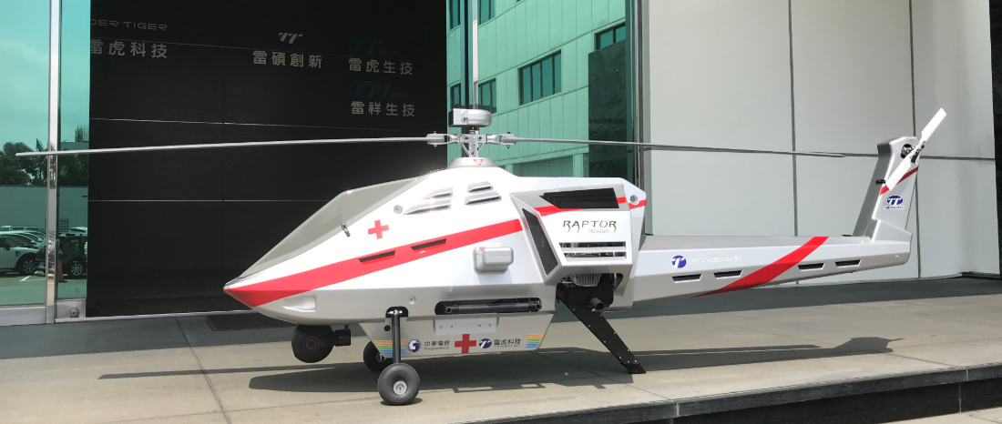
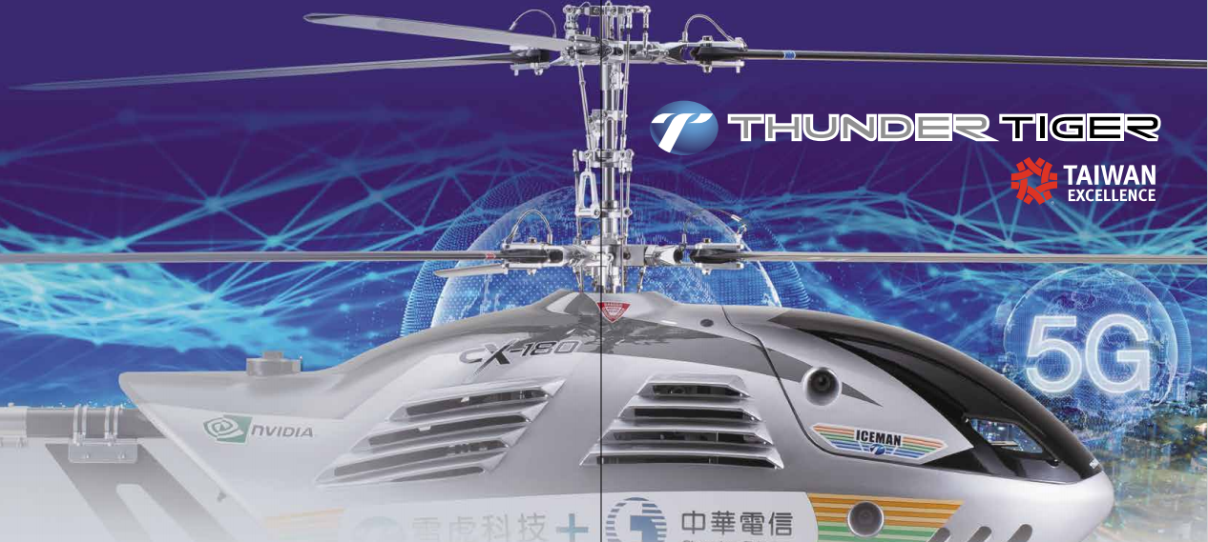
https://youtu.be/izmbLGrBWTk
https://youtu.be/TkR6jBBrLTk
2022 REPORT
December 15 , 2022

Slide 3
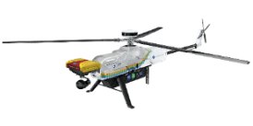
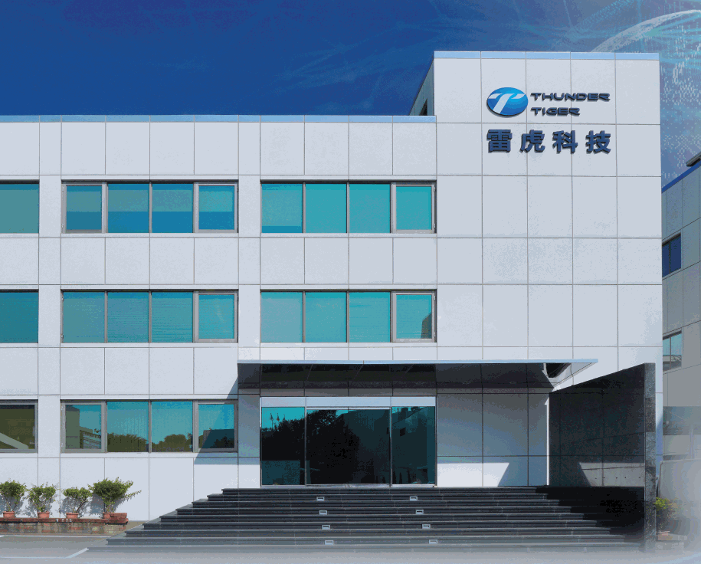
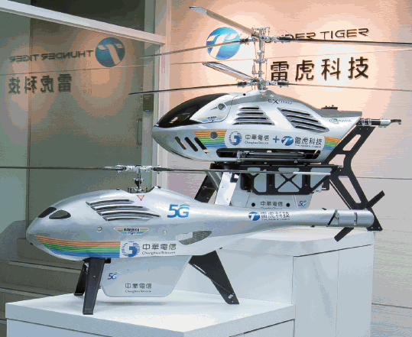
Company Introduction
雷虎科技股份有限公司 Thunder Tiger Corporation
Stock code：8033 (Taiwan Stock Exchange)
Established in Oct.1979
Paid in capital NTD132 million shares
Employee: 250 Staff (TW: 220, US: 30)
Address：NO. 7, 6TH road, Industry park Taichung, Taiwan

Slide 5
Taiwan starts to focus on Drones and Asymmetric Warfare
President Tsai Ing-wen proposed the “5+2 Innovative Industries” defense industry development policy, effectively combining government and private forces to develop the defense industry. On May 31, 2018, the Legislature passed the third reading of the "Regulations on the Development of the National Defense Industry", which prioritized domestic research and development, production of weapons and equipment, and logistical support.
President Tsai Ing-wen put forward the "six core strategic industries" on May 20, 2019, which will promote the independent research and development and manufacturing of national defense and the aviation and ship industries of the national defense and strategic industries.

Slide 6
Taiwan starts to focus on Drones and Asymmetric Warfare
President Tsai Ing-wen said in her National Day speech: In view of the situation of the Ukrainian-Russian war, she declared that she will construct "asymmetrical combat power" to develop "asymmetrical defensive operations" across the Taiwan Strait.

Slide 7
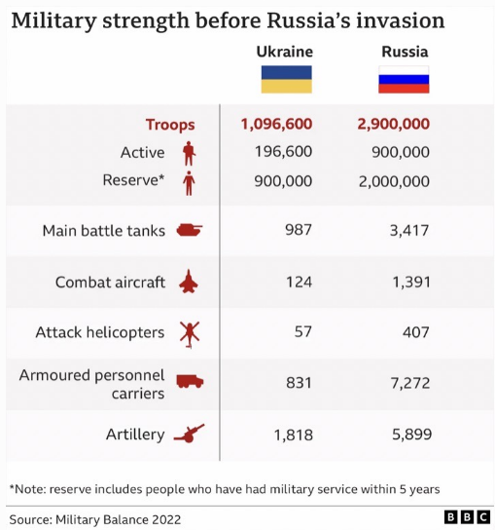
The Russian-Ukraine War’s Lesson to Taiwan

Slide 8
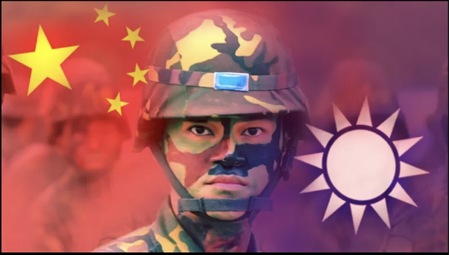
Taiwan's needs(Asymmetric warfare)

Slide 9
UAV leading manufacturers
（DJI, Skydio, Anduril, Saab)

Slide 10
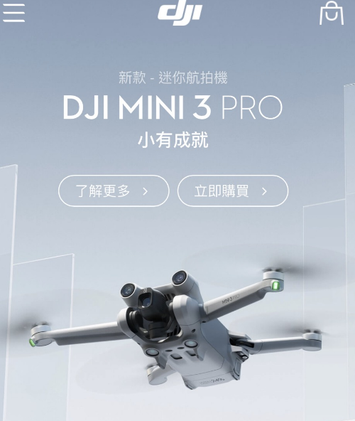
DJI (Founded in 2006, annual revenue is
about 100 billion Taiwan dollars）

Slide 11
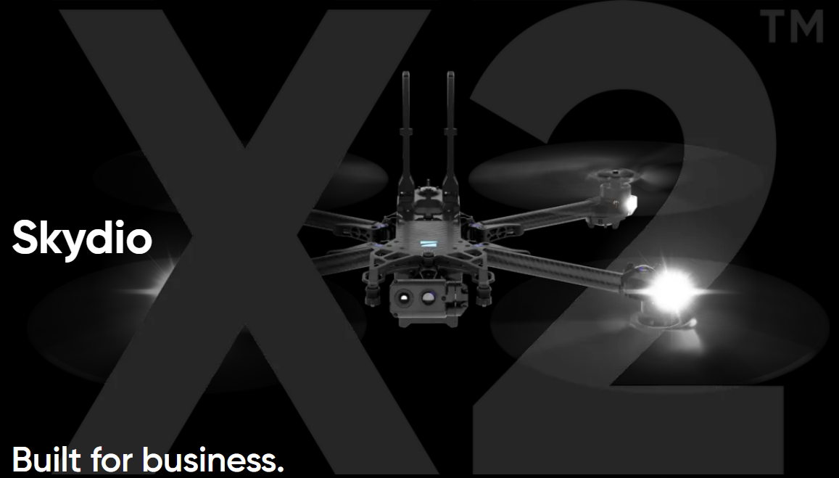
(2) USA Skydio (Founded in 2014, the market value is
1 billion US dollars）

Slide 12
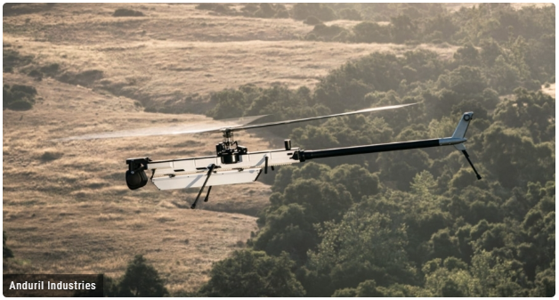
(3) USA Anduril (Founded in 2017, the market value is 13 billion US dollars)

Slide 13
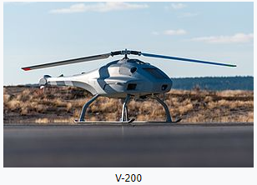
(4)Sweden Skeldar (Saab subsidiary)，Saab was founded in 1937, with a market value of 49.6 billion US dollars

Slide 14
Thunder Tiger UAV and Drone Products

Slide 15
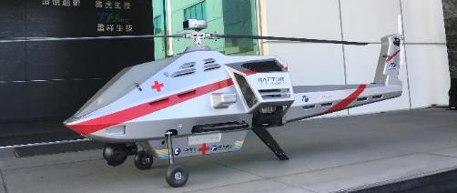
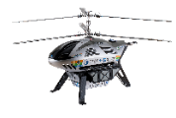
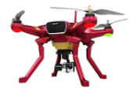
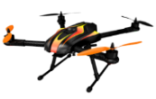
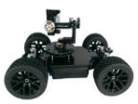
Aerospace Military grade
Industrial grade
UAV Roadmap
Consumer grade

Slide 16
Taiwan Excellence Award
2021緊急醫療物資運輸 無人直升機
2022
SkyEye 5G Helicopter
2020長滯空氫燃料 電動無人機精品獎
Won 39 times Taiwan Excellence Award
5 times Golden Award
5 times Silver Award
2020緊急空中基地台 系統精品獎
2019年空中基地台
無人機精品獎
2020海龍號聲納掃描
八軸水下機器人銀質獎
2018年空中熱影像雷達偵 測搜救無人機銀質獎
2017年農業無人機精品獎
2019年海龍號加長型水下探 勘六軸無人潛水艇金質獎
2001年60級競賽直升機金質獎
2016年海狼號潛艇銀質獎
2010年海神號潛艇金質獎
1999年30級競賽直升機金質獎
16

Slide 17
Visits by Taiwan President
and Vice President

Slide 18
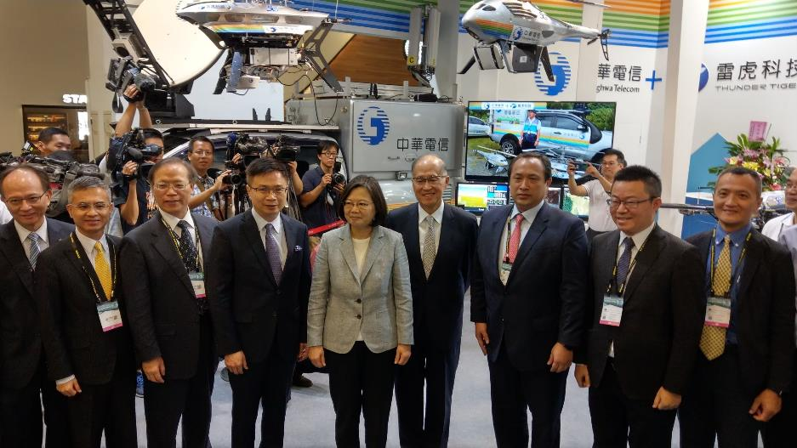
2019.8

Slide 19
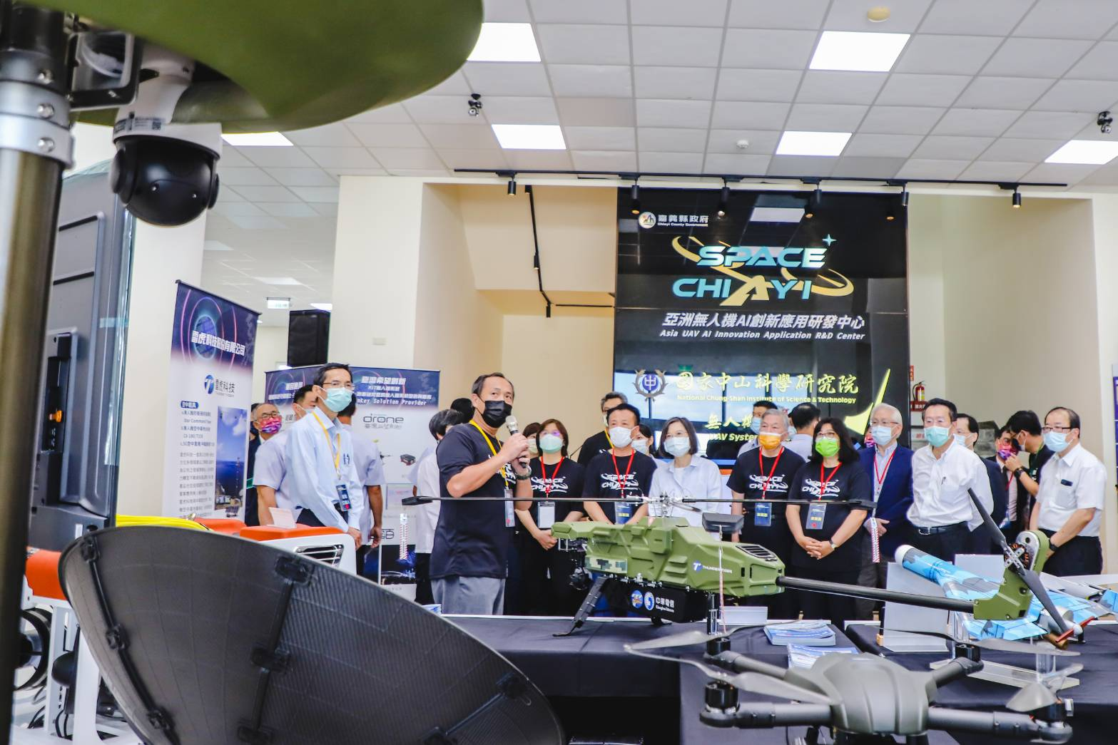
At Taiwan Chiayi’s UAV Innovation R&D Center Opening Ceremony, President Tsai personally visited the New UAV System of Thunder Tiger
2022.08.13

Slide 20
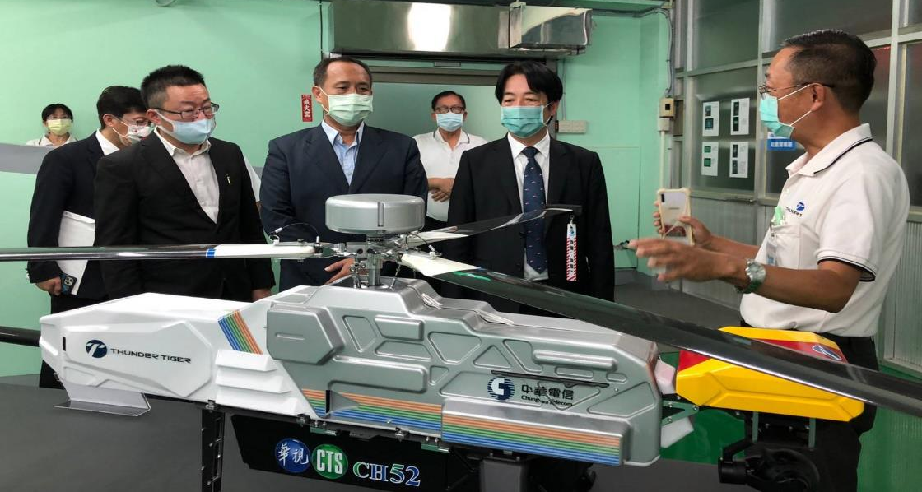
Vice President Mr. Lai came to guide Thunder Tiger
2021.10

Slide 21
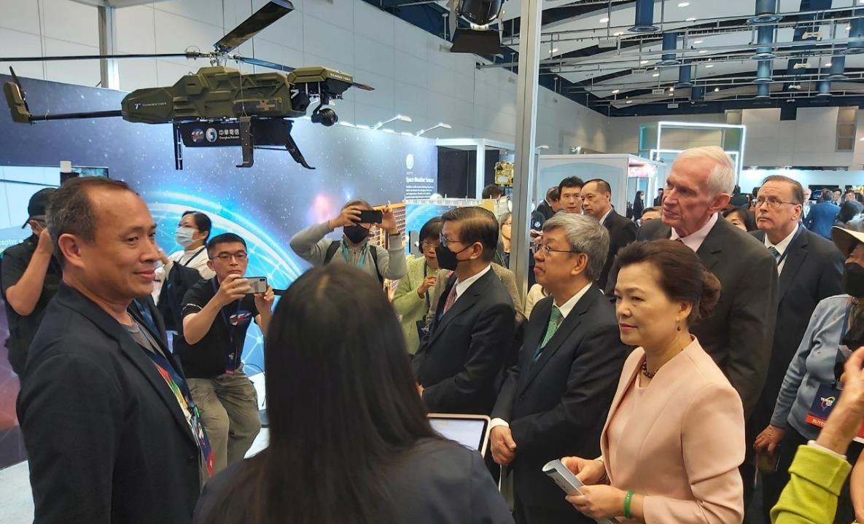
James F. Moriarty, Chairman of AIT, accompanying Minister of Economic Affairs Mrs. Wang Meihua, and former Vice President Mr. Chen to inspect latest Thunder Tiger’s Booth at Taiwan Expo Held in Washington DC.
2022.10.12

Slide 22
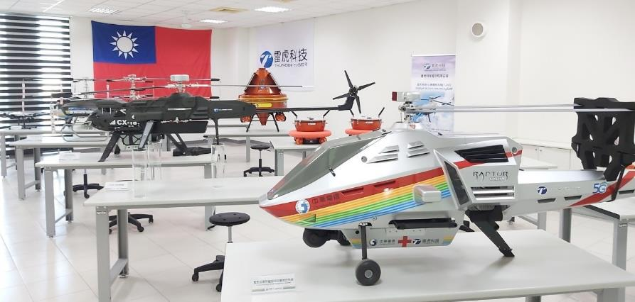
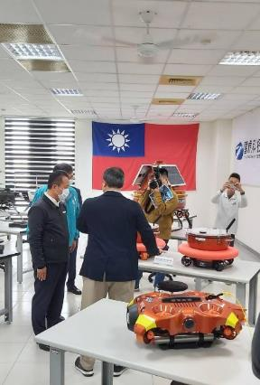
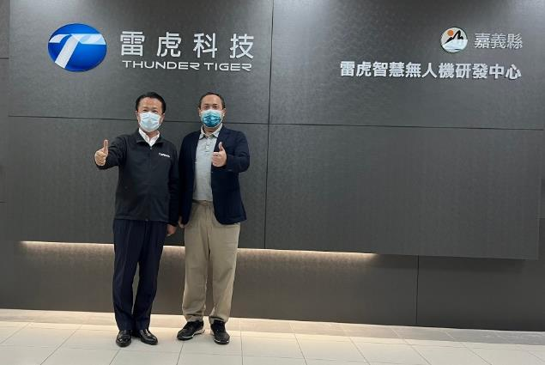
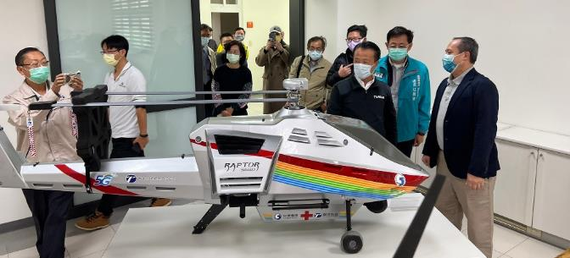
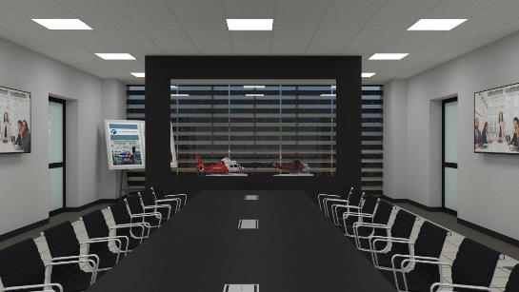
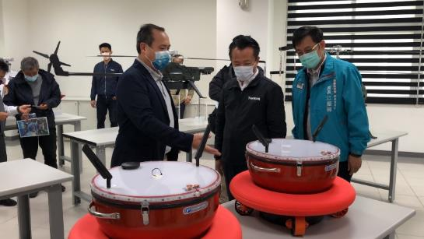
At the invitation of Chiayi County Mayor, Thunder Tiger RD Team joins in the Asia UAV AI Innovation Application R&D center to Become Member of Taiwan National Drone Team

Slide 23
(II) Key Partners in Drone and
UAV Cooperation

Slide 24
Cooperation with Chunghwa Telcom
5G Communication to Drones:
Cell on wings and relay
Medical delivery
Search and Rescue
UAV patrolling
Unmanned traffic management (UTM)
Autopilot BVLOS
trade shows and exhibitions

Slide 25
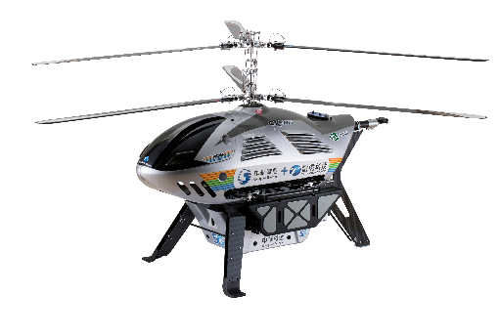
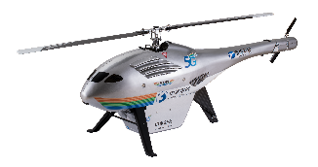
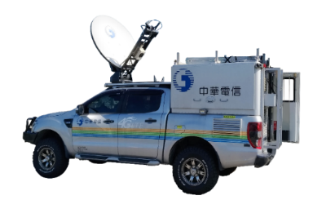
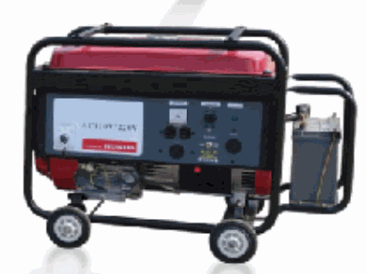
CX-180 equipped with small cell
UAV lifts off 100M
The signal can cover about 35KM
The Endurance can be up to 6~8 hours
ST-2 Satellite
Relay communication
4G/5G
Base Station
Small cell
T-150 with Repeater
Extendable mobile signal coverage
Chunghwa Telecom
Satellite ground station
And monitoring center
Repeater
20220324花蓮鳳林NCC防災演習
https://www.youtube.com/watch?v=iQIq2_7Ez5c
Instant Aerial image
Optical cable
Power cable
After the UAV lifts off
Signal coverage
Extended mobile signal coverage
mobile phone
Core network
Satellite Mobile Vehicle
generator
地型、建物
災害阻檔訊號
Disaster area 1
(no mobile phone signal)
Disaster area 2
(no mobile phone signal)
Flying Mobile Base Station

Slide 26
2022 NCC Disaster Relief Show Held in Taiwan Hualien

Slide 27
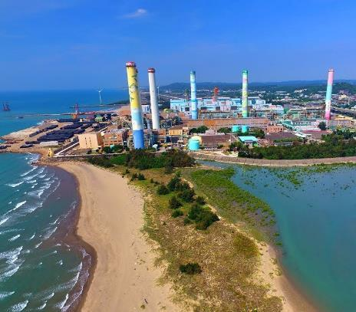
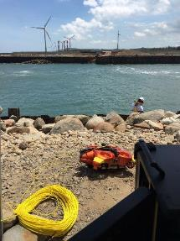
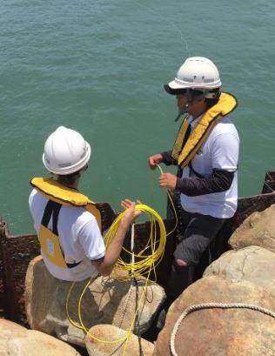
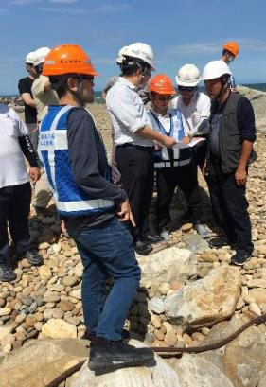
Thunder Tiger ROV( Submarine) Inspecting Taipower Natural Gas Power Plant Cooling Water Pipes
34

Slide 28
(III) Upcoming UAV Products and Technologies Developed
By Thunder Tiger

Slide 29
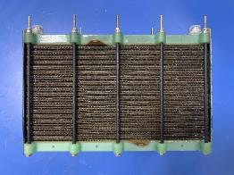
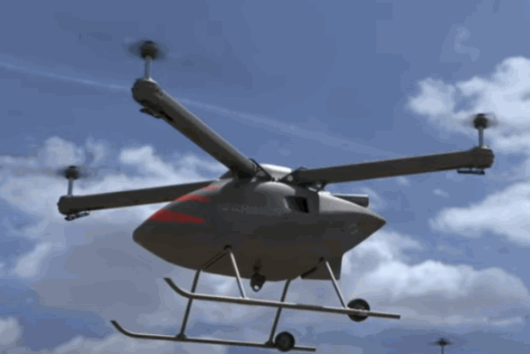
Hybrid Power Systems
The development of a new type of porous composite flow channel can effectively maximize the reaction efficiency (discharge current) and maintain the stability of the reaction/output.
Power generation unit sealing and new electric stack locking design to take into account the lightweight and high power requirements of the electric stack.
Lightweight and high power stack
1400W
1.25kg
(G2金屬堆)
Stack Power Density Comparison (UAV)
廠牌/型號 | 電堆重(kg) | 功率 (W) | 功率密度(W/kg)
ITRI MCL | 1.25 | 1400 | >1100
Intelligent Energy 800W | 0.93 | 800 | 860
Troowin (武漢眾宇動力) | 2.25 | 1350 | 600
Spectronik Protium3000 | 6.44 | 3000 | 466
Doosan(韓國斗山) | 1.7 | 1300 | 765
BShark(黑鯊智能) | 1.3 | 800 | 615
(abridged general view)

Slide 30
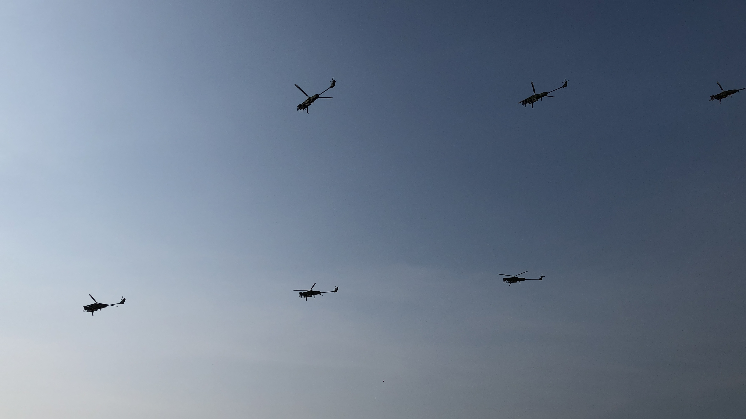
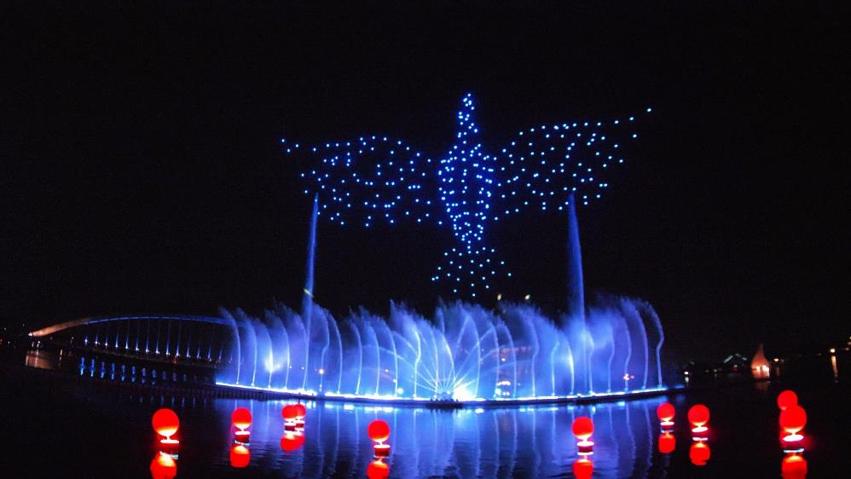
Drone show
Drones and Helicopters Swarming Technologies and Applications
T200 Helicopter Swarm in the air
2021.10.10

Slide 31
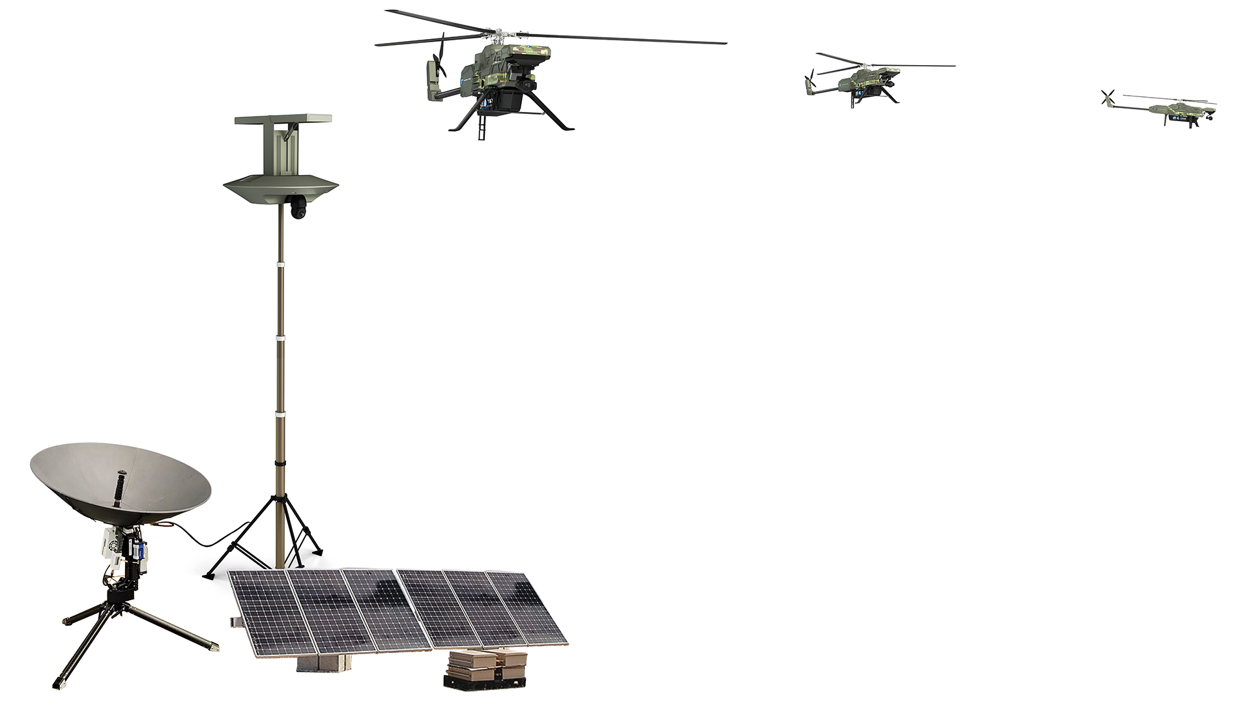
UAV Defense Command Tower
Anti-UAV Radar
Next Generation UAV RepeaterT-200
portable satellite
MEC

Slide 32
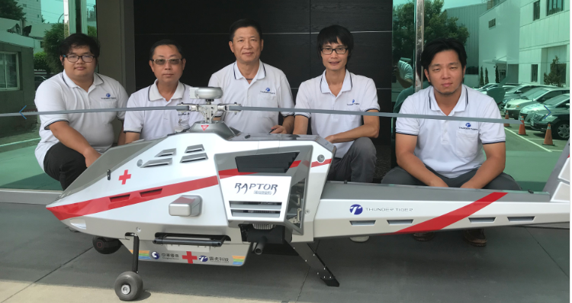
RAPTOR T- 250
Unmanned Helicopter for Emergency Medical Service

Slide 33
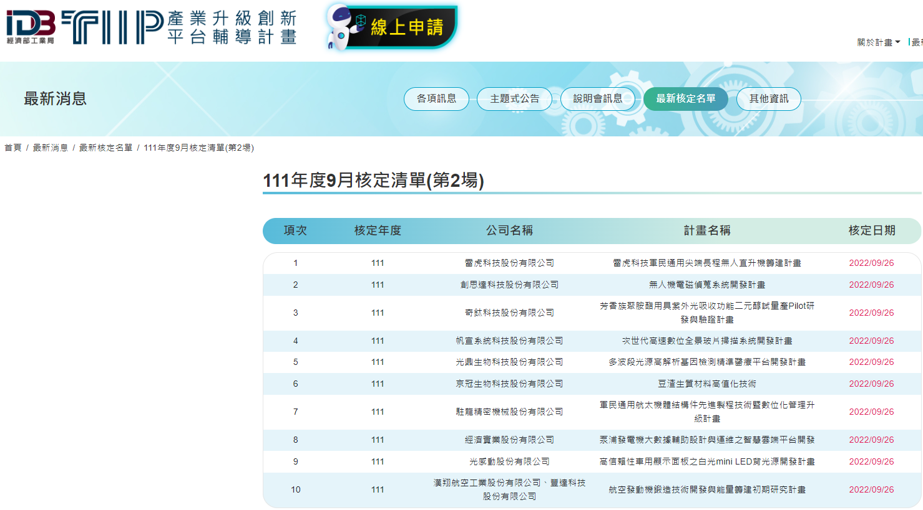
Thunder Tiger Technology military-civilian common cutting-edge long-range unmanned helicopter
T400 Helicopter Approved and Funded by Taiwan’s Ministry of Economic Affairs

Slide 34
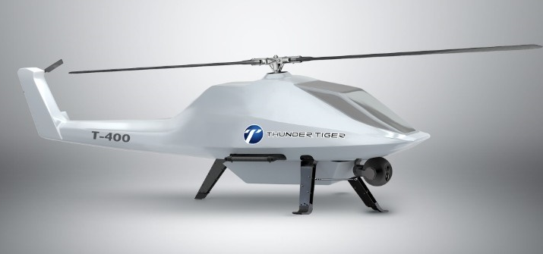
雷虎科技軍民通用尖端長程無人直升機T400
The prototype is expected to be exhibited in 2023

Slide 35
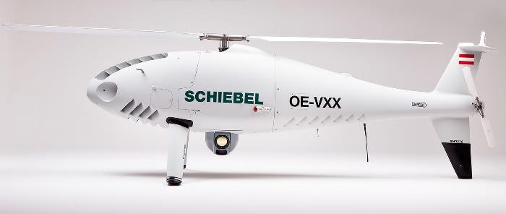
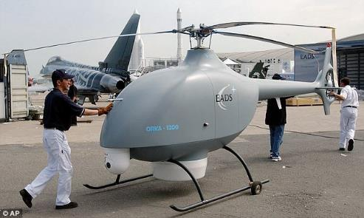
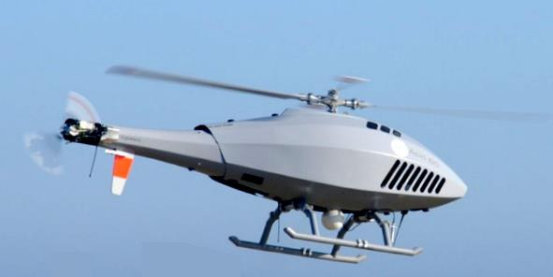
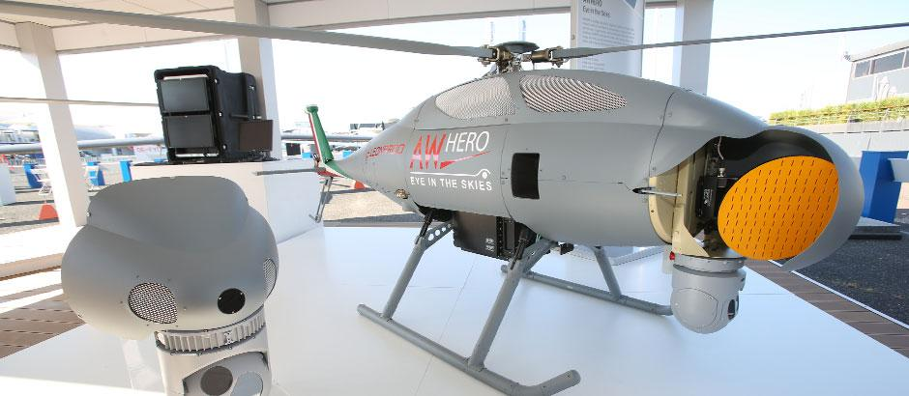
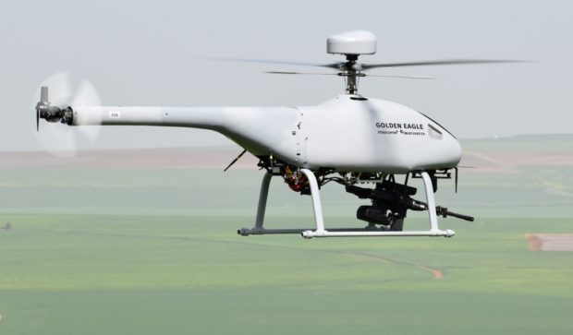
T-400 Military and
Civilian General Purposes UAV
T-400 unmanned helicopter

Slide 36
Taiwan Government’s Initiatives to Select Leading Local Taiwanese UAV Manufacturers to be Awarded with Drone Projects and Orders in the Future
˙依經濟部工業局11月1日公告「軍用商規無人機系統整合主導廠商遴選作業要點申請須知」 辦法辦理。
˙「雷虎科技」申請本次「軍用商規無人機統整合主導廠商遴選計畫」之「三類5款機型」

Slide 37
Future UAV Trends(1)
1. Power improvement: motor, engine power
requirements, and battery performance.
2. Flight control system: upgrade towards AI,
taking into account technology and air
safety management requirements

Slide 38
Future UAV Trends(2)
3. Obstacle avoidance system: dodge obstacles
on time and establish a flight safety system.
4. Flight beyond visual range: increase cruise
and control distance.
5. Smart takeoff and landing without GPS.

Slide 39
Opportunities and Visions For Taiwan Drone Companies
Asymmetric warfare and the flight against the big invader foster more needs for military and commercial mid and large size drone and UAV products.
Drones to be 100% Made In Taiwan and to exclude any MIC components.
To Integrate with Taiwan’s ICT industry and form a competitive world class drone and UAV industry and supply chain to win market share worldwide.

Slide 40
2022 Financials

Slide 41
Consolidated Financial Statement
In thousands of TWD
Year Item | Three-year consolidated income statement
 | 2019 | 2020 | 2021 | 2022Q3
Operating Revenue | 815,458 | 908,235 | 1,183,168 | 799,181
Operation Profit (Loss) | (51,532) | (2,833) | 73,265 | 5,411
Non-operating Income | (18,827) | 44,045 | (21,132) | 30,600
Pre-tax profit (Loss) | (70,359) | 41,212 | 52,133 | 36,011
Net income (Loss) | (46,379) | 24,471 | 25,852 | 25,351
Shareholders of the parent | (63,629) | 3,005 | 22,177 | 12,040

Slide 42
Thank You for Your Attention

