Slide 1
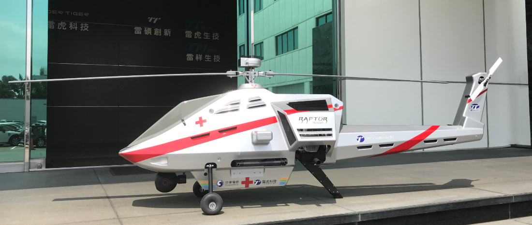
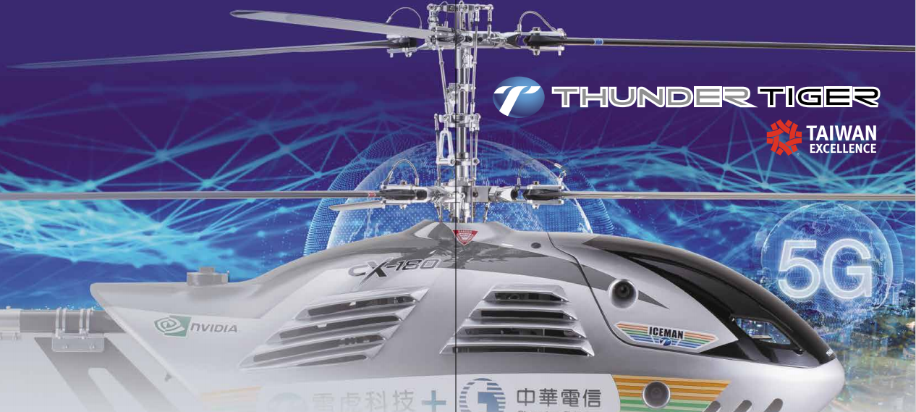
2021 REPORT
December 22 , 2021

Slide 2
一、Company Introduction
二、Future Outlook
三、2021 Financials

Slide 3
Company Introduction

Slide 4
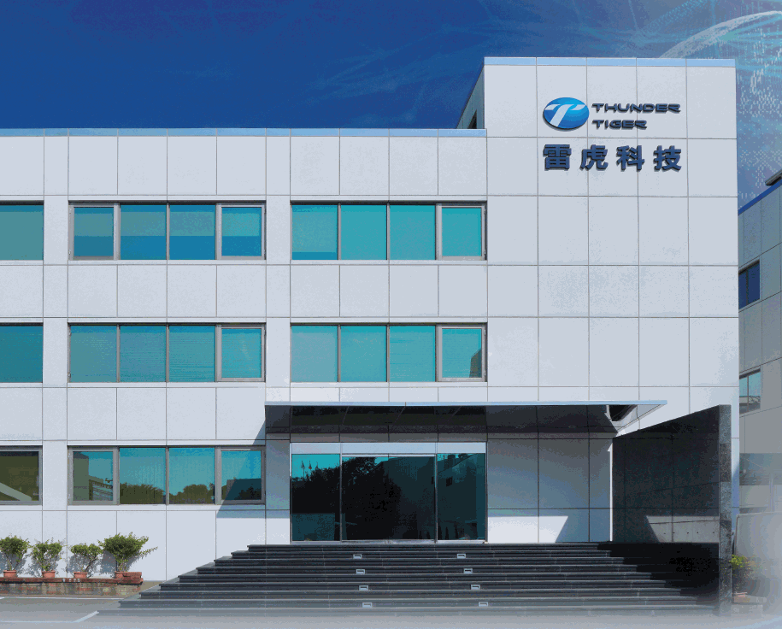
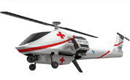
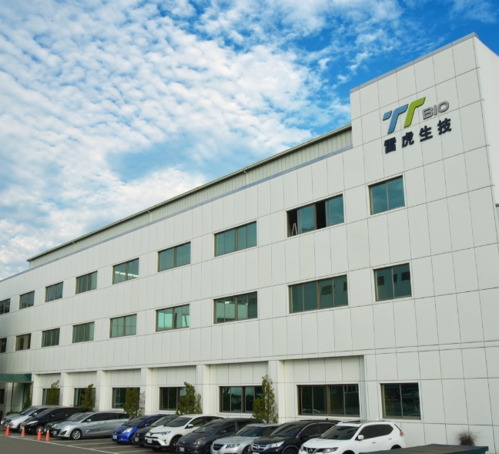
雷虎科技集團 Thunder Tiger Group
Stock code: 8033
(Taiwan Stock Exchange)
Established in Oct.1979
Shares outstanding：132 million shares)
Employee: 200 Staff (TW: 170, US:30)

Slide 5
Located in Taichung Industrial Park Manufacturers Association
Location: Taichung Industry Park, Taiwan

Slide 6
Chairman: Kwan Ju, Chen The current chairman of IBF VENTURE CAPITAL Master of London School of Economics and Political Science Bachelor of Carnegie Mellon University
General Manager：
Sheng Chieh, Su
Served as Investment Chief of Nice Group
Master of Boston University
Bachelor of National Taiwan Normal University

Slide 7
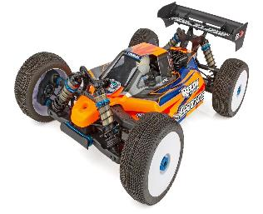
TTS
Taoyuan City, Guishan Dist.
T T
Taichung Industry Park
R&D and manufacturing of UAV, high-precision metal precision processing technology, professional development, design, technology and quality assurance departments.
Production and design of Remote control model products.
ASSOCIATED ELECTRICS
California, USA
Mainly for design and marketing on remote control car
TTBIO
Taichung Industry Park
Production and sales of high and low speed dental drills, electric dental drills, automatic dental drill maintenance machines and related peripheral parts of medical equipment
Emerging stock code: 6493

Slide 8
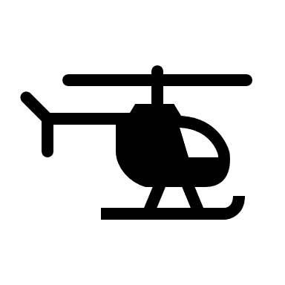
Transformation started in 2000, striving to upgrade from traditional precision processing and manufacturing to smart manufacturing
Actively invest in medical equipment and unmanned vehicles manufacturing & R&D

Slide 9
Key business activities:
R&D and manufacturing of unmanned vehicles, high-precision metal precision processing technology
R&D and manufacturing of medical equipment (including extracorporeal shock wave therapy equipment, high and low speed dental drills, electric dental drills, automatic dental drill maintenance machines and scaler machines, etc.)

Slide 10
Major Customers
Across US, Japan and Taiwan

Slide 11
Manufacturing Process

Slide 12
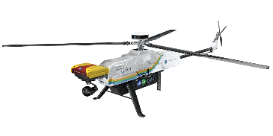
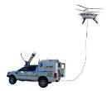
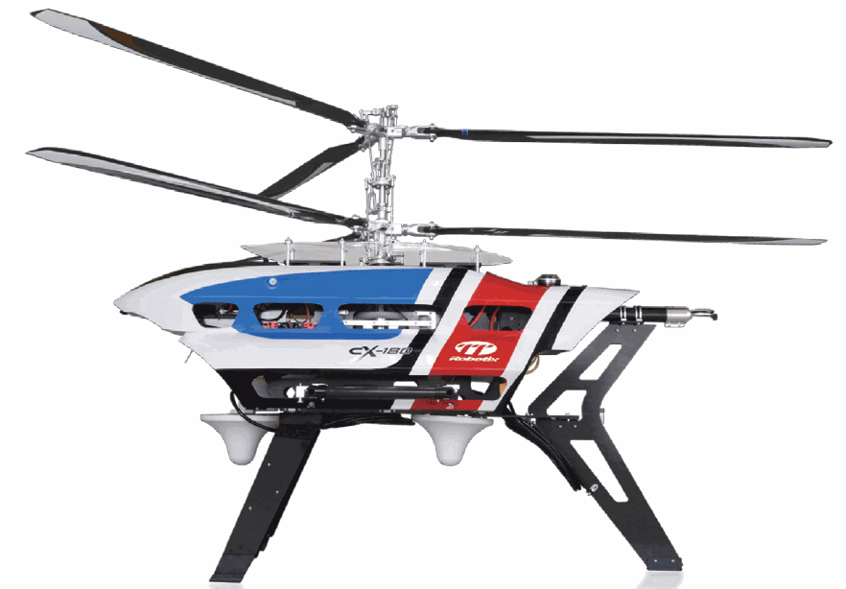
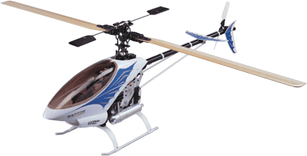
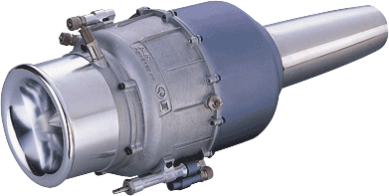
Taiwan Excellence Award
Won 39 times Taiwan Excellence Award
5 times Golden Award
5 times Silver Award
2022
2021
2020
Unmanned aerial vehicle
2020
2020
2019
2019
2018
2016
2017
2010
Underwater Remote Operation vehicle
2001
1998
1997
1996
3

Slide 13
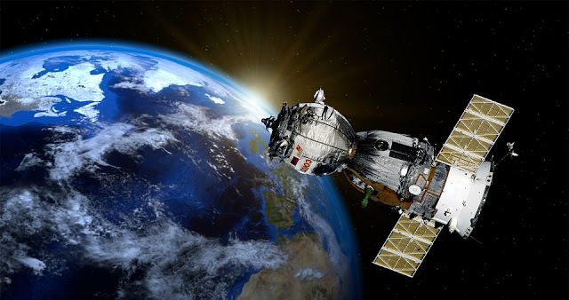
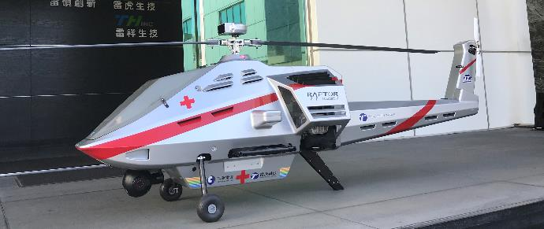
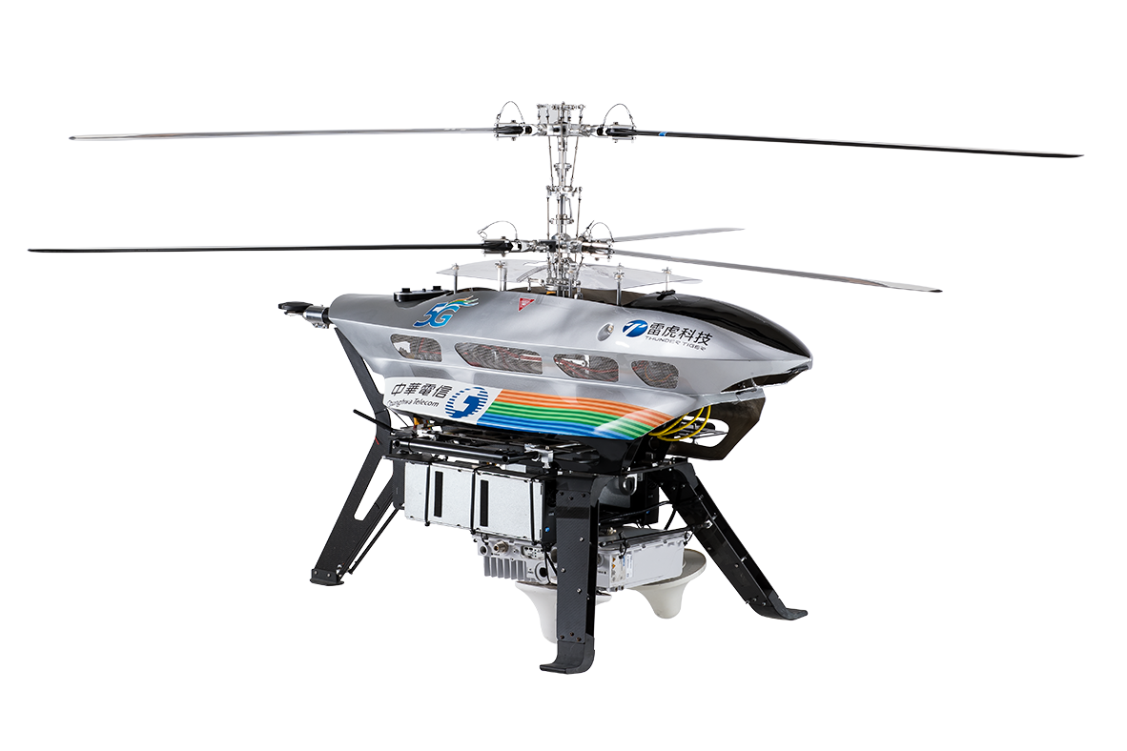
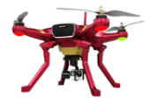
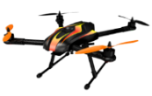
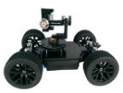
Aerospace military grade
Industrial grade
UAV Roadmap
Consumer grade
5

Slide 14
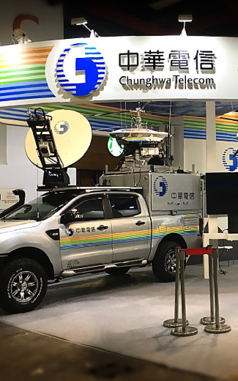
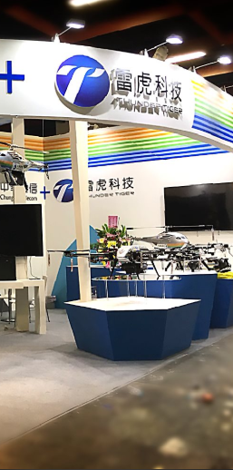
The cooperation between unmanned vehicles and innovative applications of 5G communication technology includes:
Multi-faceted cooperation with Chunghwa Telecom
Unmanned vehicle base station
Medical and cargo transportation
Security and disaster relief monitoring
UAV flight management (UTM) system
Participate in related domestic and foreign exhibitions (Aerospace Exhibition, Telecom Exhibition... etc.) to expand business opportunities

Slide 15
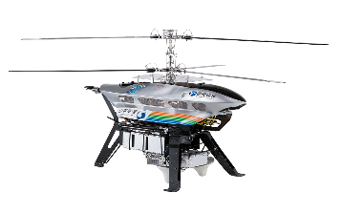
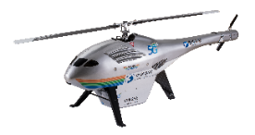
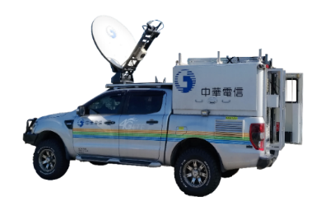
CX-180 equipped with small cell
UAV lifts off 100M
The signal can cover about 35KM
The Endurance can be up to 6~8 hours
ST-2 Satellite
Relay communication
4G/5G
Base Station
Small cell
T-150 with Repeater
Extendable mobile signal coverage
Chunghwa Telecom
Satellite ground station
And monitoring center
Repeater
Instant Aerial image
Optical cable
Power cable
After the UAV lifts off
Signal coverage
Extended mobile signal coverage
mobile phone
Core network
Satellite Mobile Vehicle
generator
Disaster area 1
(no mobile phone signal)
Disaster area 2
(no mobile phone signal)
Flying Mobile Base Station

Slide 16
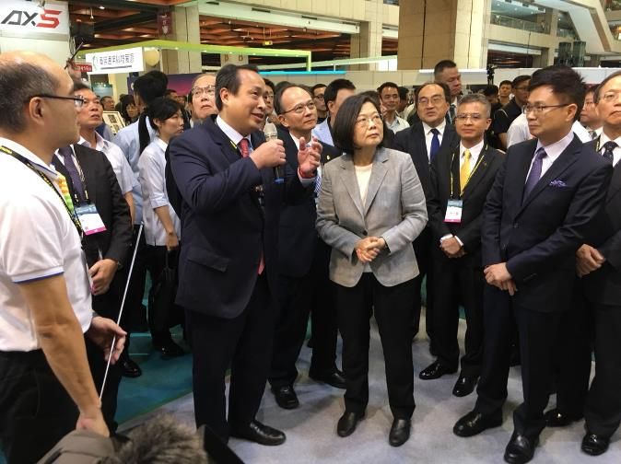
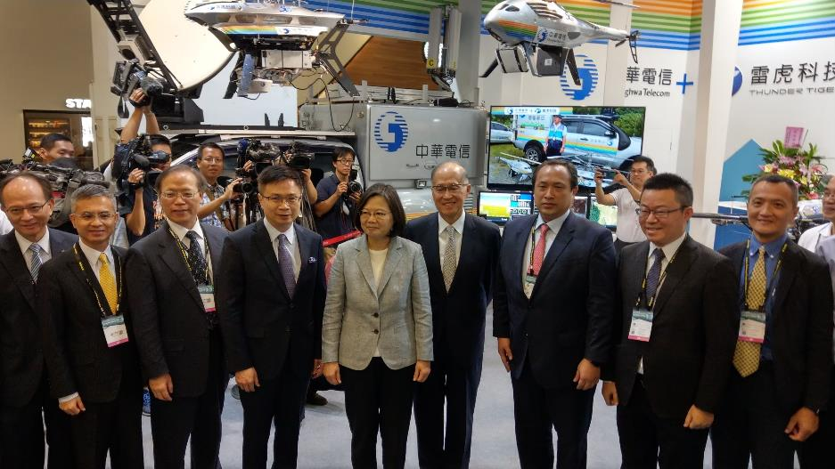
Taipei Aerospace & Defense Technology Exhibition
2019.8

Slide 17
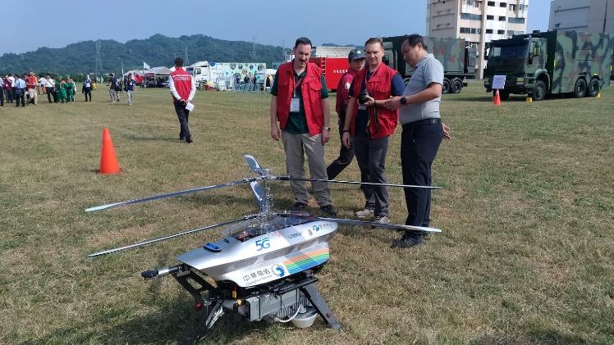
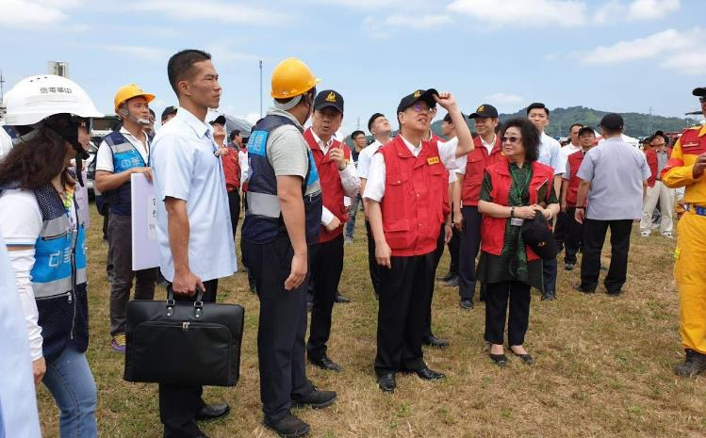
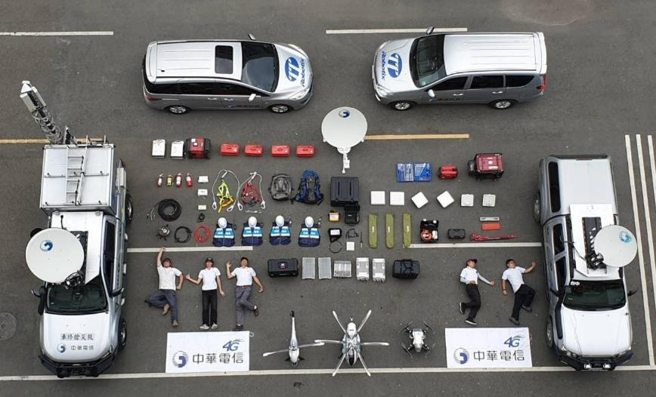
Fire & Disaster Relief Drill
2019.9

Slide 18
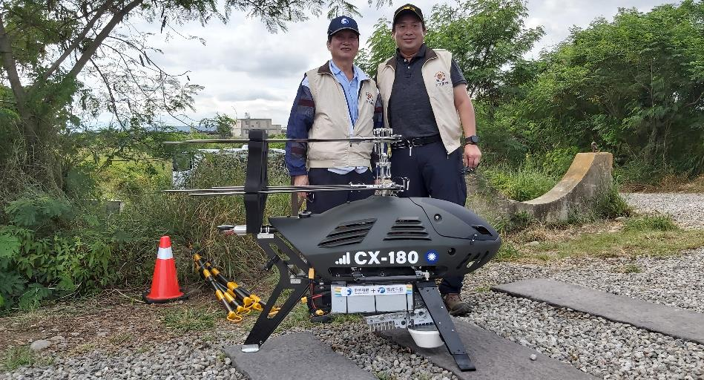
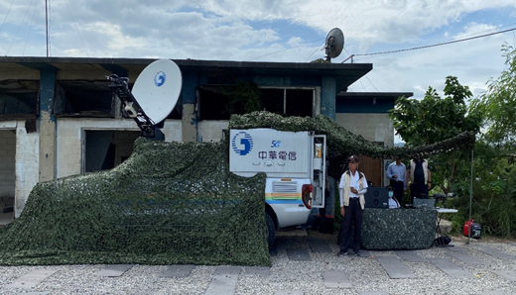
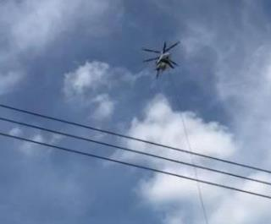
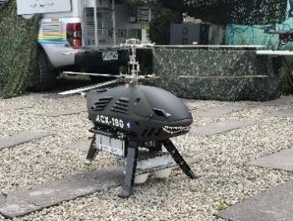
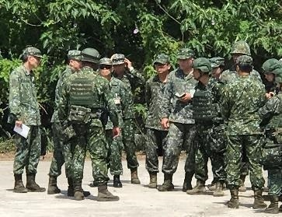
Military Drill
2020.7

Slide 19
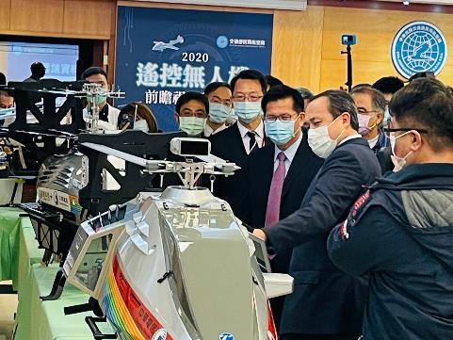
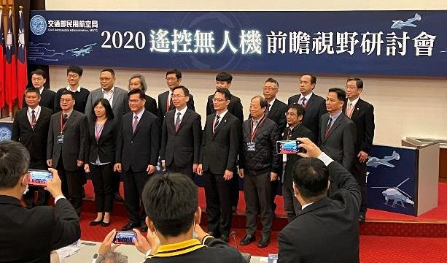
UAV Foresight Seminar in Ministry of Transportation and Communications
2020.12

Slide 20
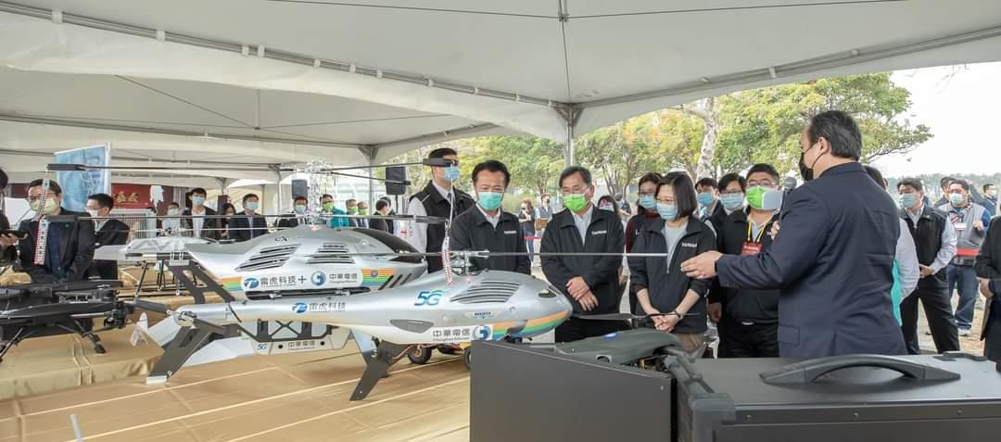
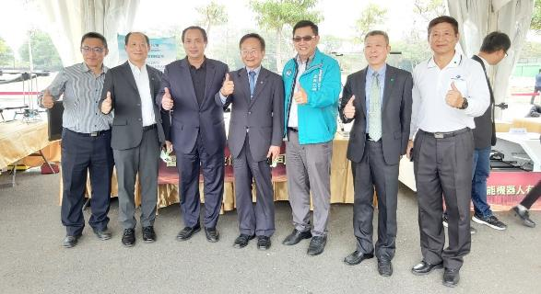
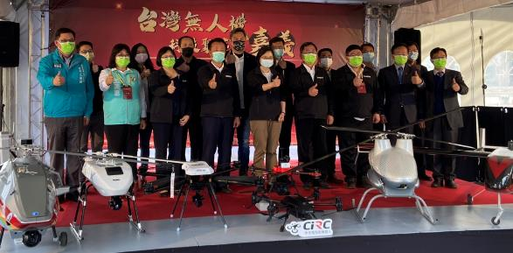
President Tsai Visiting Thunder Tiger Booth
2021.1.22

Slide 21
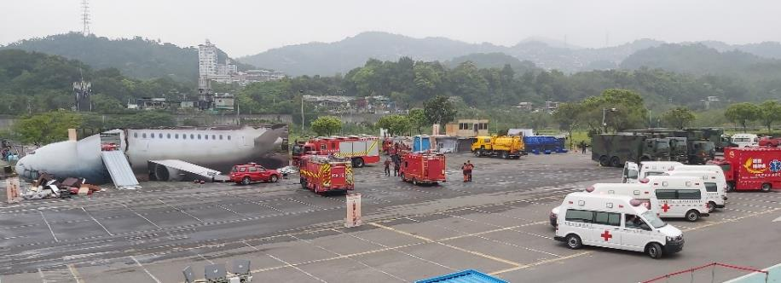
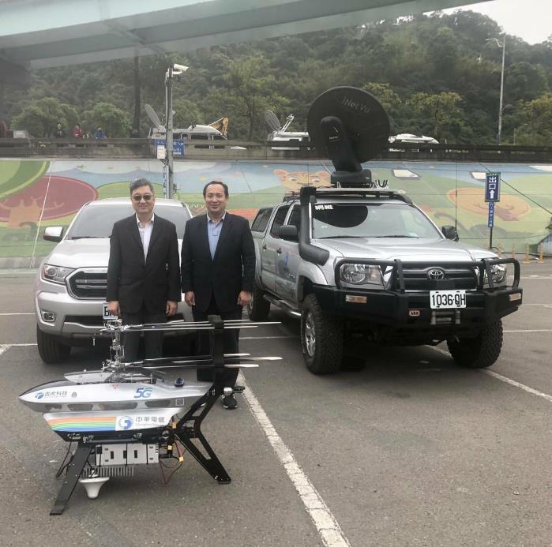
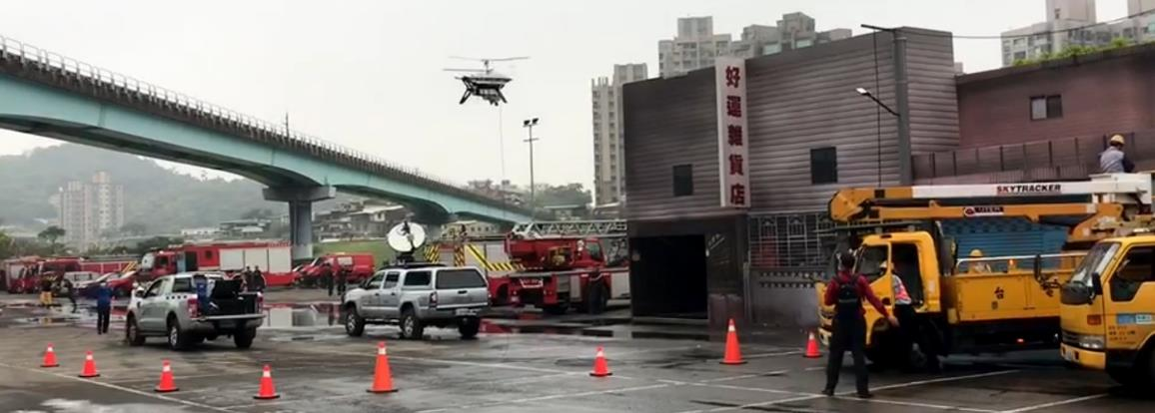
Taipei City Drill for Disaster Relief
2021.03.18

Slide 22
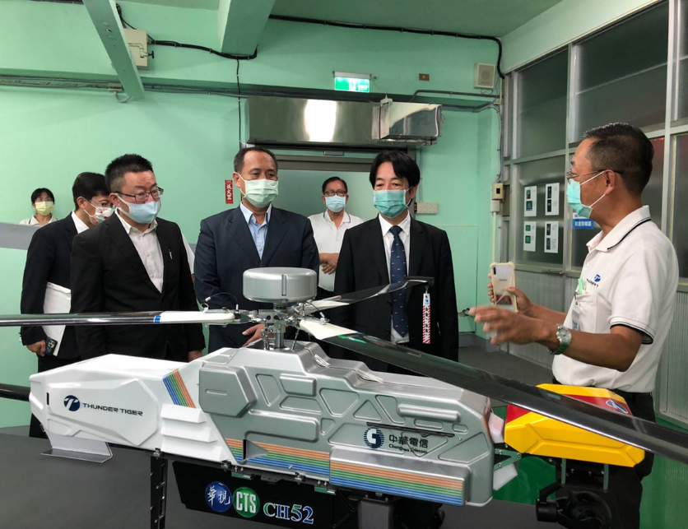
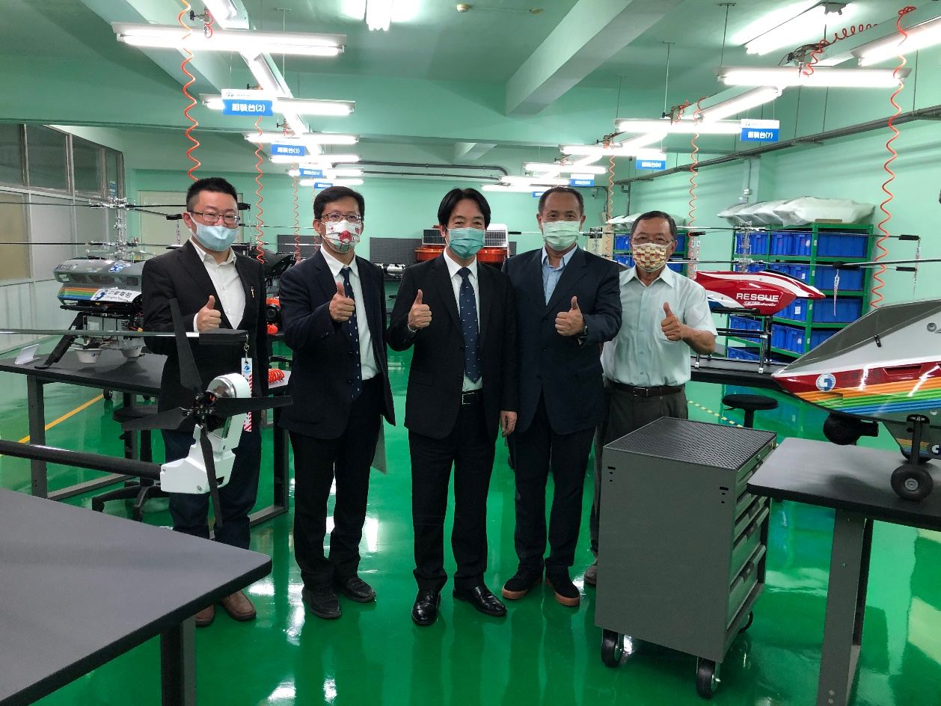
Vice President Lai Visiting Thunder Tiger
2021.10.5

Slide 23
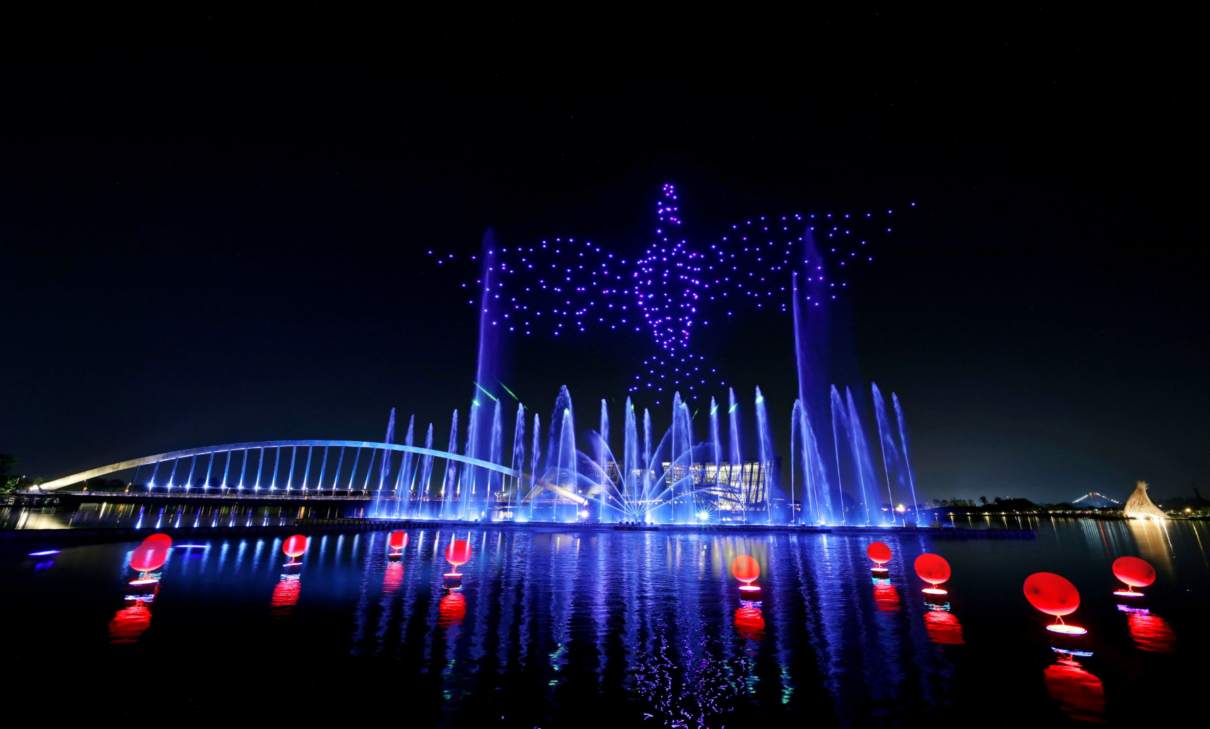
Thunder Tiger Cooperating with Taiwan Drone 100 to Demonstrate Drones and Boats Swarm Show in Taiwan National Palace Museum
2021.10.10

Slide 24
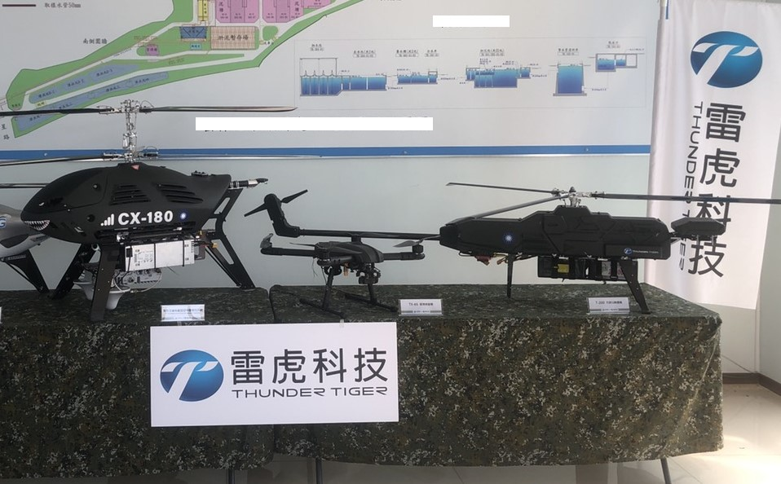
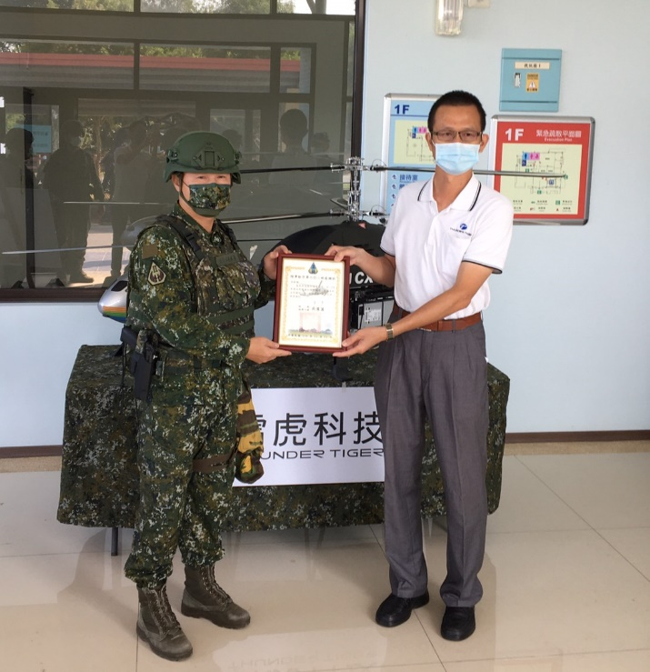
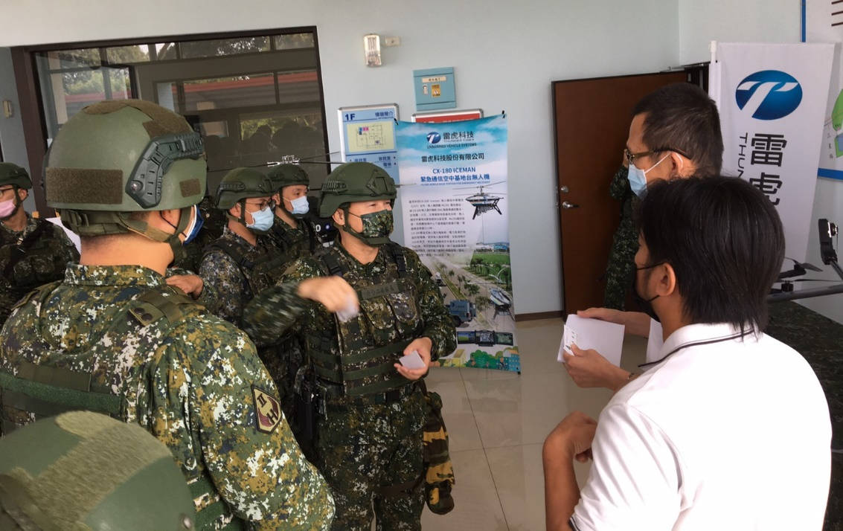
Military Exercise Demonstration
2021.11.11

Slide 25
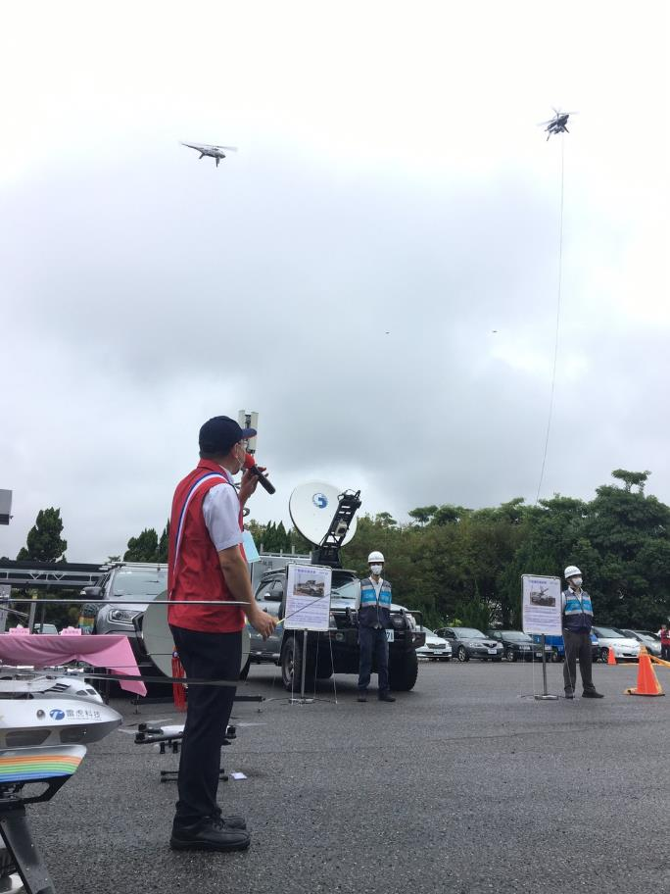
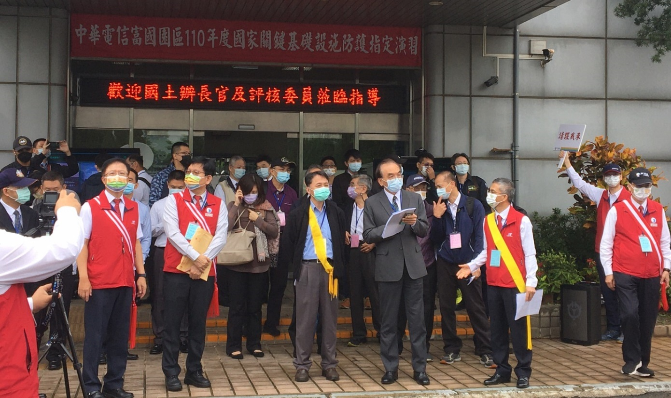
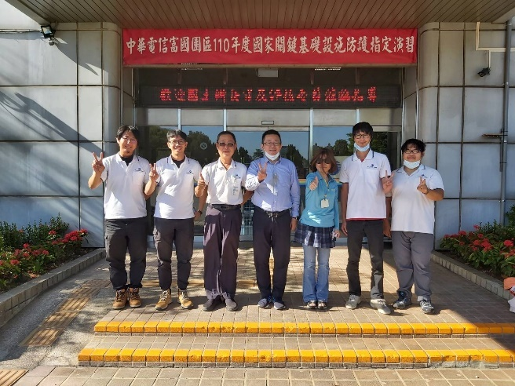
Critical Infrastructure Protection Drill
2021.11.18

Slide 26
Future Outlook

Slide 27
On-Going Projects

Slide 28
RAPTOR EMS 250
Unmanned Helicopter for
Emergency Medical Service
Emergency medical supplies transportation tasks in disaster areas
Long Endurance and high payload capacity
Can bring serum/medicine/AID equipment, etc., and arrive at the medical institution in need within the effective time
Weight (W/O Oil): 16kg
Maximum take-off weight: 35kg
Load equipped weight: 15kg max
Endurance: 2~4 hours
(depending on load and fuel)

Slide 29
National Yang Ming Chiao Tung University
Co-developed AI remote control off-road vehicle

Slide 30
Rotors Inspection
Offshore wind power is an important green energy policy of government authorities. Thunder Tiger will invest in the development of UAV in the application of renewable energy.
UAV detects the fan of the Wind turbines, which can improve efficiency and work safety
Aimed at the application of drones in the maintenance of large equipment, close inspection of large equipment such as electric wires, electrical towers and wind turbines
Take high-resolution images and use artificial intelligence to analyze potential problems and defects

Slide 31
2021
Financials

Slide 32
Sales Growth
In thousands of TWD
Date | Jan. | Feb. | Mar. | Apr. | Man | Jun. | July | Aug. | Sep. | Oct. | Nov
2020 | 75,030 | 72,981 | 68,924 | 63,119 | 62,158 | 88,401 | 69,749 | 53,409 | 55,225 | 100,008 | 95,491
2021 | 100,103 | 77,504 | 117,488 | 117,318 | 98,396 | 92,600 | 80,039 | 94,973 | 137,697 | 103,873 | 83,925
2021 Jan. to Nov. YTD sales YOY growth is 36.79%

Slide 33
Consolidated Financial Statement
In thousands of TWD
Year Item | Three-year consolidated income statement
 | 2018 | 2019 | 2020 | 2021Q1-Q3
Operating Revenue | 871,835 | 815,458 | 908,235 | 914,668
Operation Profit (Loss) | (5,070) | (51,532) | (2,833) | 80,899
Non-operating Income | (16,772) | (18,827) | 44,045 | (17,348)
Pre-tax profit (Loss) | (21,842) | (70,359) | 41,212 | 63,551
Net income (Loss) | (29,295) | (46,379) | 24,471 | 33,711
Shareholders of the parent | (48,783) | (63,629) | 3,005 | 32,468

Slide 34
Comparison of consolidated income and loss in recent two years
In thousands of TWD
Year Item | Comparison of consolidated income and loss
 | 2020Q1-Q3 | 2021Q1-Q3
Operating Revenue | 610,908 | 914,668
Operation Profit (Loss) | (12,418) | 80,899
Non-operating Income(Loss) | 44,374 | (17,348)
Pre-tax profit | 31,956 | 63,551
Net income | 19,768 | 33,711
Shareholders of the parent | (520) | 32,468
ADD: 2021 Q3 Impairment loss | 30,482 | 17,371
Adjusted: Shareholders of the parent | 29,962 | 49,839

Slide 35
Thank you!

