Slide 1
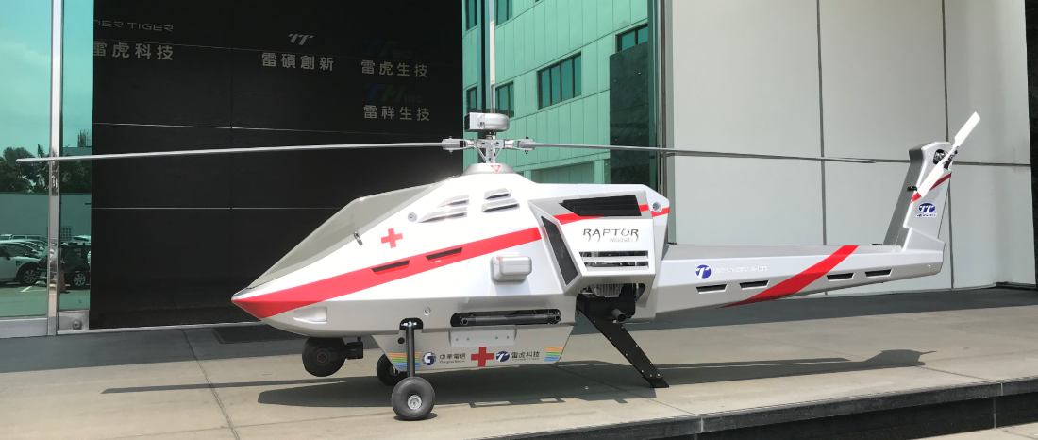
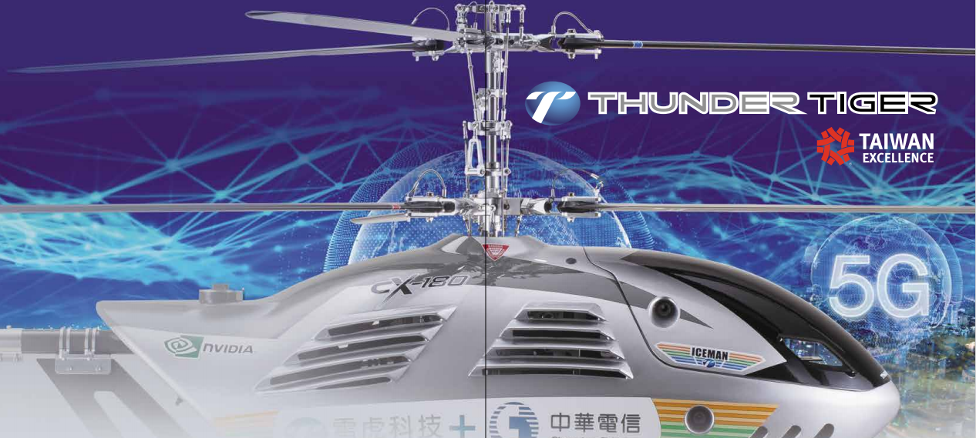

2020 REPORT
Dec 29, 2020

Slide 2
一、Company Introduction
二、Future Outlook
三、2020 Financials

Slide 3
Company Introduction

Slide 4
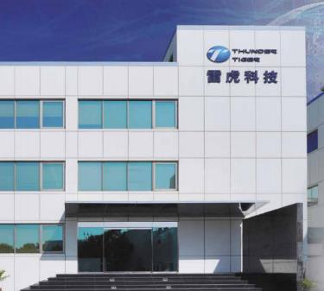

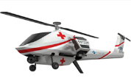
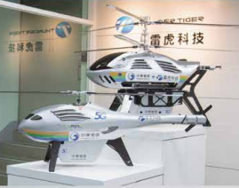

雷虎科技股份有限公司
Thunder Tiger Corporation
Stock code: 8033 (Taiwan Stock Exchange)
Established in Oct.1979
Paid in capital NTD112 million shares)
Employee: 200Staff (TW: 170, US: 30)
Location: Taichung Industry Park,Taiwan

Slide 5

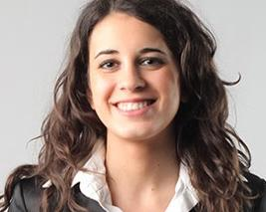


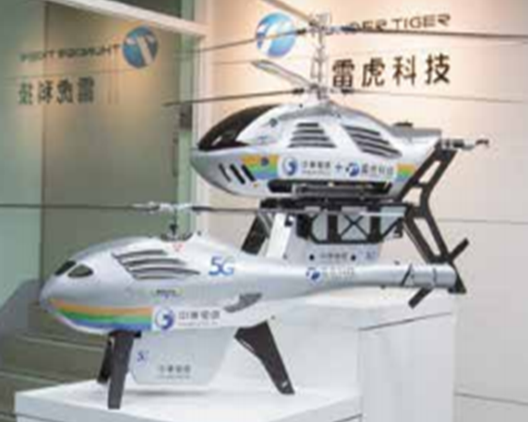

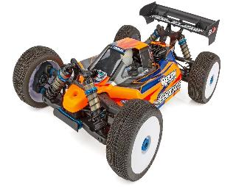
T T
Taichung Industry Park
TTS
Taoyuan City, Guishan Dist.
R&D and manufacturing of UAV, high-precision metal precision processing technology, professional development, design, technology and quality assurance departments.
Production and design of remote control model products.
TTBIO
Taichung Industry Park
Production and sales of high and low speed dental drills, electric dental drills, automatic dental drill maintenance machines and related peripheral parts of medical equipment
Emerging stock code: 6493
TT
Taichung Industry Park
Aseptic bottle & Caps injection Division

Slide 6
Market Size
■Global sales will reach 2.4 Million
units in 2023.
■The compound rate is 67%.
■DJI sales was RMB 16.7 Billion in 2018.

Slide 7




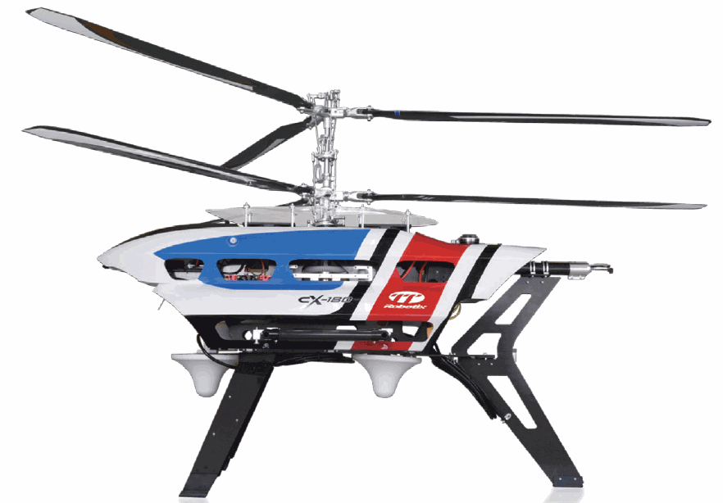

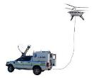

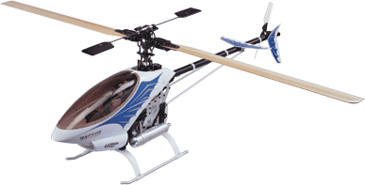





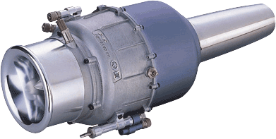

Taiwan Excellence Award
1998年微型渦輪噴射引擎金質獎
Won 38 times Taiwan Excellence Award
5 times Golden Award
5 times Silver Award
2020海龍號聲納掃描八軸水下
機器人銀質獎
2020長滯空氫燃料
電動無人機精品獎
2021
2019年空中基地台
無人機精品獎
緊急醫療物資運輸無人直升機
2020緊急空中基地台
系統精品獎
2018年空中熱影像雷達偵測搜救無人機銀質獎
2017年農業無人機精品獎
2019年海龍號加長型水下探勘六軸無人潛水艇金質獎
2016年海狼號潛艇銀質獎
2001年60級競賽直升機金質獎
2010年海神號潛艇金質獎
1999年30級競賽直升機金質獎
1997年四衝程引擎銀質獎
1996年二衝程引擎銀質獎

Slide 8
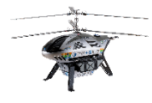




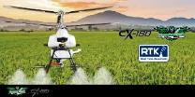
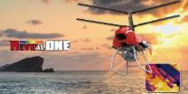
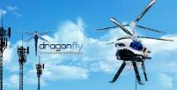
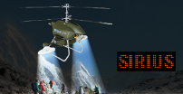

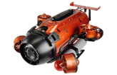
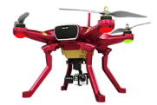
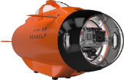
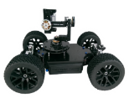
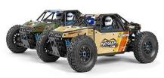
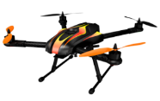

UAV Roadmap
消費級
Industrial grade
Aerospace military grade
RC Autonomous 5G + AI
Consumer grade

Slide 9


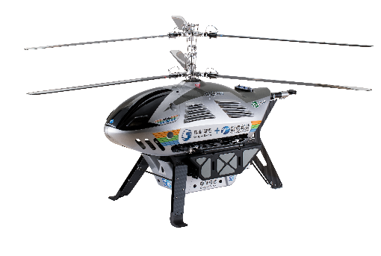


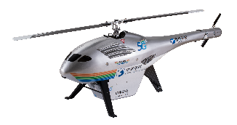



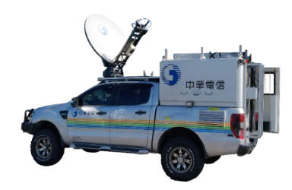


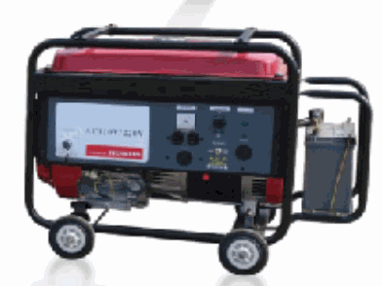

CX-180 equipped with small cell
UAV lifts off 100M
The signal can cover about 35KM
The Endurance can be up to 6~8 hours
ST-2 Satellite
Relay communication
4G/5G
Base Station
Small cell
T-150 with Repeater
Extendable mobile signal coverage
Chunghwa Telecom
Satellite ground station
And monitoring center
Repeater
Instant Aerial image
Optical cable
Power cable
After the UAV lifts off
Signal coverage
Extended mobile signal coverage
mobile phone
Core network
Satellite Mobile Vehicle
generator
地型、建物
災害阻檔訊號
Disaster area 1
(no mobile phone signal)
Disaster area 2
(no mobile phone signal)
Flying Mobile Base Station

Slide 10

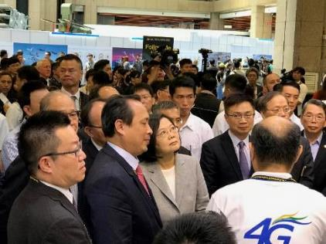

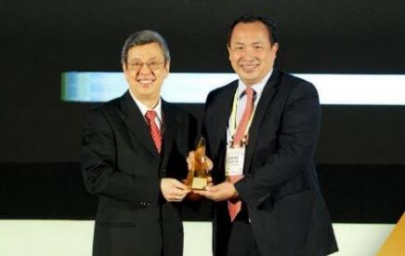
Achievement
● April,2019/5GPilot opening
● August,2019/Taipei Aerospace and Defense Exhibition
● July,2019/New Taipei City Fire Department drill
● September,2019/National Disaster Prevention Day drill
● December,2019/NCCTaitung drill
● April,2020/NCC Flood Control Drill in Taitung, Southern District
● April,2020 /5GPilot Anniversary
● July,2020/Military exercises
● October,2020/Chiayi UAV Innovation Application
● December,2020/Homeland Security CIP drill
● December,2020/Civil Aviation Administration of UAV Forum

Slide 11

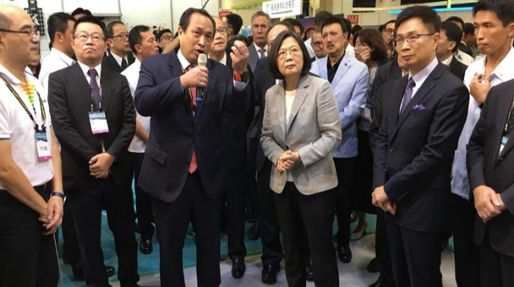
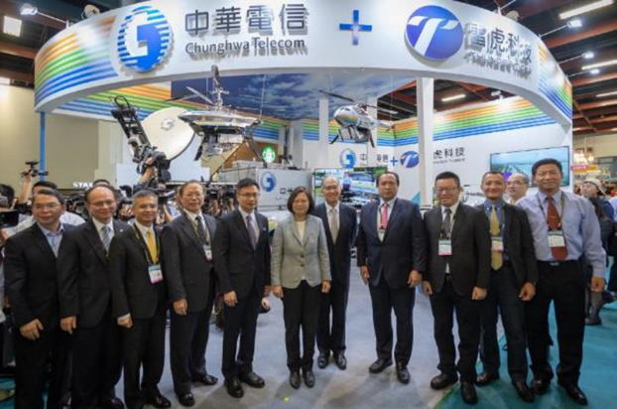

Taipei Aerospace & Defense Technology Exhibition

Slide 12
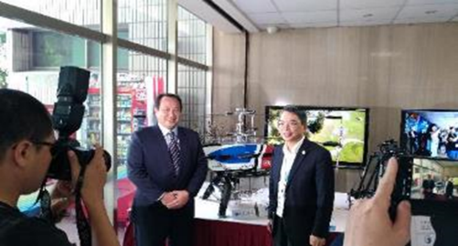
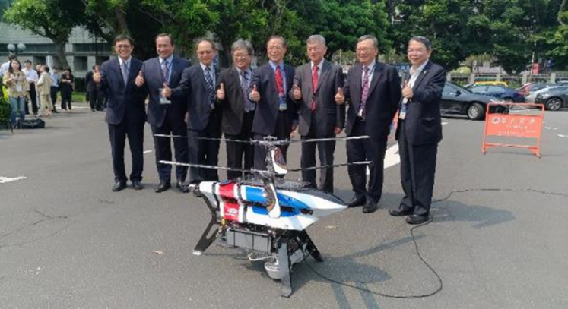

5G Pilot Team Anniversary

Slide 13
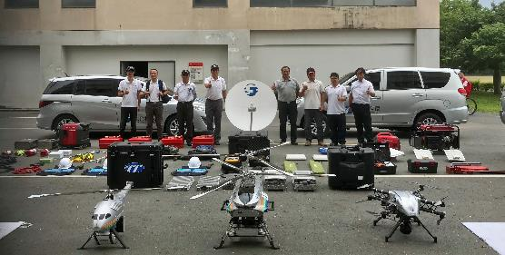
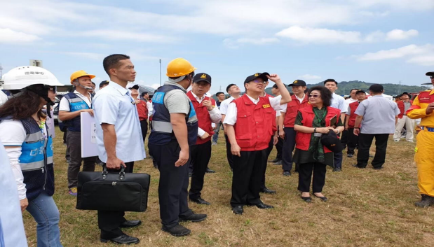
Fire & Disaster Relief Drill

Slide 14
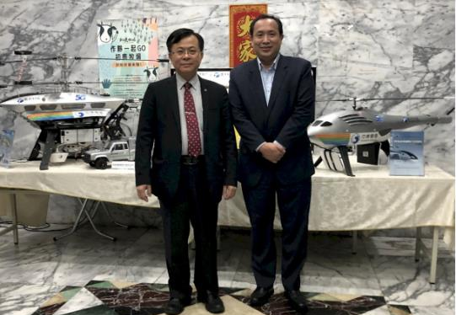
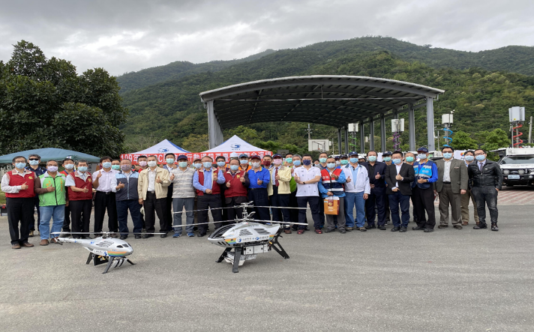
NCC
Flood Prevention Drill

Slide 15
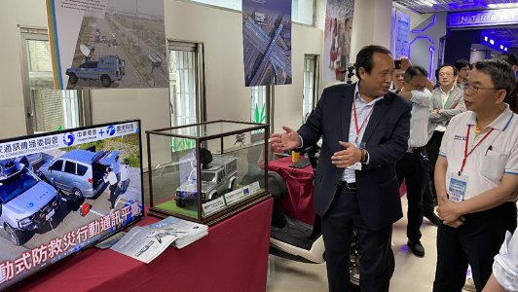
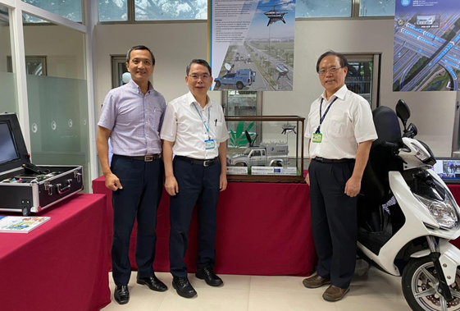
5G Pilot Team Anniversary

Slide 16
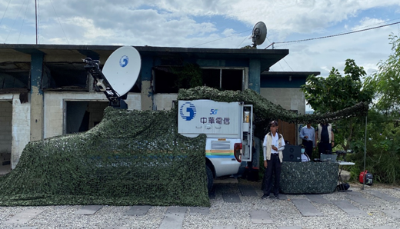
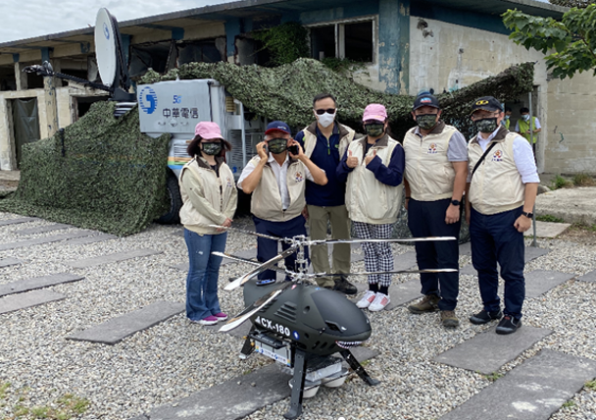
Military Drill

Slide 17
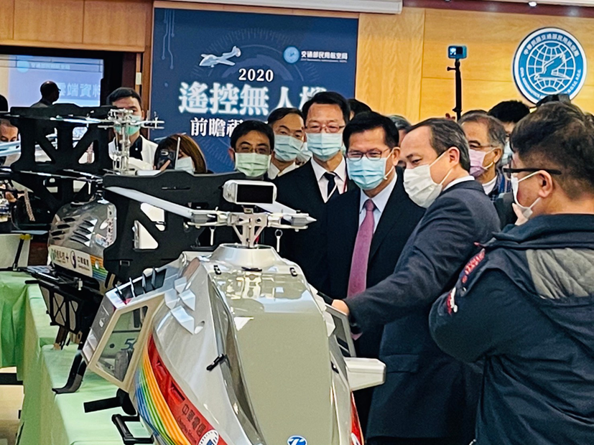
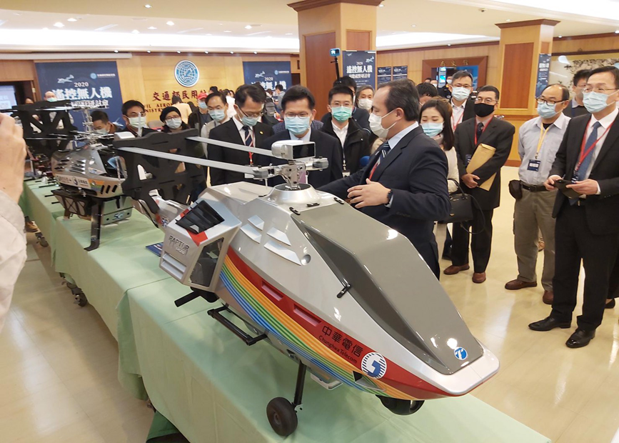
UAV Foresight Seminar in Ministry of Transportation and Communications

Slide 18


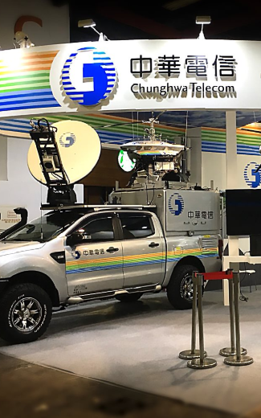
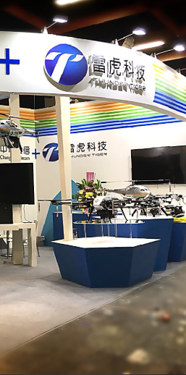
Multi-faceted cooperation with Chunghwa Telecom
The cooperation between unmanned vehicles and innovative applications of 5G communication technology includes:
Unmanned vehicle base station
Medical and cargo transportation
Security and disaster relief monitoring
UAV flight management (UTM) system
Participate in related domestic and foreign exhibitions (Aerospace Exhibition, Telecom Exhibition... etc.) to expand business opportunities

Slide 19
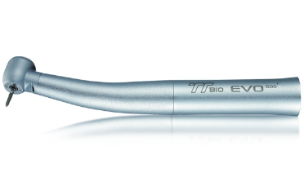

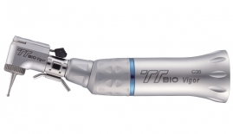
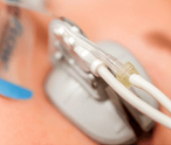


雷虎生技股份有限公司
TTBIO Corporation
Biotech medical dental material and activator bladder adapter
America's largest dentist distributor
U.S. large-scale healthcare and equipment

Slide 20
Future Outlook

Slide 21
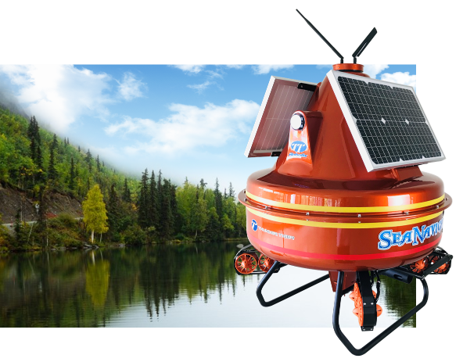
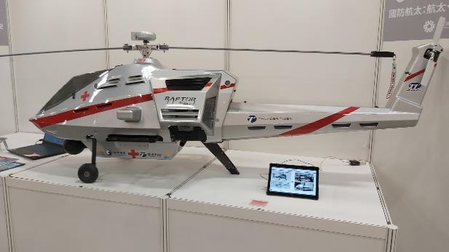
On Going Projects (5G+AI)
High-speed railway inspection
Identification of small objects on the coast
Navigator unmanned vehicle

Slide 22




Air Traffic Management/
Track Inspection

Slide 23








Micro Objects Identification

Slide 24


Engine Powered Heli
( RAPTOR EMS 250 )
Unmanned Helicopter for Emergency
Medical Service
Emergency medical supplies transportation tasks in disaster areas
Long Endurance and high payload capacity
Can bring serum/medicine/AID equipment, etc., and arrive at the medical institution in need within the effective time
Weight (excluding oil): 16kg
Maximum take-off weight (including load): 35kg
Load equipped weight: 15kg max
Endurance: 6 hours (depending on load and fuel)

Slide 25

Unmanned Helicopter for Emergency Medical Service

Slide 26


Features
Twin-engine unmanned helicopter, capable of carrying medical or equipment weighing up to 15kg
Continuous flight for 4~6 hours, the mission radius can reach 150~200 kilometers
The dual protection mechanism of the dual-engine power system can immediately start and automatically land in an emergency
The top of the helicopter is designed with LiDAR obstacle avoidance sensor and AI image recognition system
Real-time detection of surrounding obstacles to increase flight safety
GPS-DENIED environment

Slide 27





LiDAR obstacle avoidance sensor, AI image recognition system
LiDAR scans can capture details around rails and structures to reveal deeper insights into the asset.
Bridges
Communications Towers
TRANSMISSION LINES

Slide 28


Slide 29


SEA NAVIGATOR
Integrate a five-in-one detection and monitoring system for water robots, water quality testing equipment, high-definition cameras, sonar and underwater positioning

Slide 30


Application
● Integrated high-efficiency remote control system
● 100% designed and manufactured in Taiwan
● Real-time monitoring of water quality monitoring values
● HD video surveillance
● The best choice for high-tech water quality monitoring

Slide 31



Slide 32



Cooperate with National Chengchi University, Chiao tung University and the Ministry of Science and Technology for unmanned vehicles for AI navigation.

Slide 33


Rotors Inspection
Offshore wind power is an important green energy policy of government authorities. Thunder Tiger will invest in the development of UAV in the application of renewable energy.
UAV detects the fan of the Wind turbines, which can improve efficiency and work safety
Aimed at the application of drones in the maintenance of large equipment, close inspection of large equipment such as electric wires, electrical towers and wind turbines
Take high-resolution images and use artificial intelligence to analyze potential problems and defects

Slide 34





Low Orbit Satellite Communication
Drones and low-orbit satellites create greater range of communications

Slide 35


Invite to visit our booth in 2021 Taipei Aerospace & Defense Technology Exhibition and Drone Taiwan.

Slide 36






Radio Controlled Cars
The remote control car of ASSOCIATED ELECTRICS is mainly based on racing.
R&D Director: Cliff Lett;
Champion driver
The company was established in California, USA, established in 1964
Currently 30 employees
Mainly for design and marketing

Slide 37


Aseptic Bottles & Caps Injection Division

Slide 38
Medical Device Division
Back to 2019 sales and profits levels.

Slide 39
2020
Financials

Slide 40
Sales Growth
In thousand of TWD
年 月 | Jan. | Feb. | Mar. | Apr. | May | Jun. | Jul. | Aug. | Sep. | Oct. | Nov.
2019 | 70,825 | 57,348 | 80,041 | 62,705 | 75,170 | 84,782 | 72,455 | 44,277 | 72,171 | 75,579 | 61,925
2020 | 75,030 | 72,981 | 68,924 | 63,119 | 62,158 | 88,401 | 69,749 | 53,409 | 55,225 | 100,008 | 95,491
2020,Jan to Nov. YOY is 6.33%;
2020, Oct. YOY is 32%;
2020, Nov. YOY is 54%。

Slide 41
Consolidated Financial Statement
In thousand of TWD
Year Item | Three-year consolidated income statement
 | 2016 | 2017 | 2018 | 2019Q3
Operating Revenue | 830,805 | 871,835 | 815,458 | 610,908
Operation Profit (Loss) | (70,660) | (5,070) | (51,532) | (12,418)
Non-operating Income | 1,824 | (16,772) | (18,827) | 44,374
Pre-tax profit (Loss) | (68,836) | (21,842) | (70,359) | 31,956
Net income (Loss) | (77,732) | (29,295) | (46,379) | 19,768
Shareholders of the parent | (88,526) | (48,783) | (63,629) | (520)

Slide 42
Comparison of consolidated income and loss in recent two years
年 度 項 目 | 雷虎科技最近期合併損益比較
 | 2019年1-9月 (核閱數) | 2020年1-9月 (核閱數)
營業收入 | 618,296 | 610,908
營業損益 | (25,161) | (12,418)
營業外收入及支出 | 17,932 | 44,374
稅前淨利(損) | (7,229) | 31,956
稅後淨利(損) | (5,814) | 19,768
稅後淨利(損)- 歸屬母公司 | (19,951) | (520)
加回: 2020年1-9月已提列信用減損損失 | - | 30,482
調整後: 歸屬母公司稅後淨利(損) | (19,951) | 29,962
In thousand of TWD
Year Item | Comparison of consolidated income and loss
 | 2019 Q3 | 2020 Q3
Operating Revenue | 618,296 | 610,908
Operation Profit (Loss) | (25,161) | (12,418)
Non-operating Income | 17,932 | 44,374
Pre-tax profit (Loss) | (7,229) | 31,956
Net income (Loss) | (5,814) | 19,768
Shareholders of the parent | (19,951) | (520)
ADD: 2020 Q3 Impairment loss | - | 30,482
Adjusted: Shareholders of the parent | (19,951) | 29,962

Slide 43

Thank you!

